Slide 1

WHAT IS THE UNITED STATES OF AMERICA?
ARLINGTON NATIONAL CEMETERY HISTORY EDUCATION SERIES

Slide 2
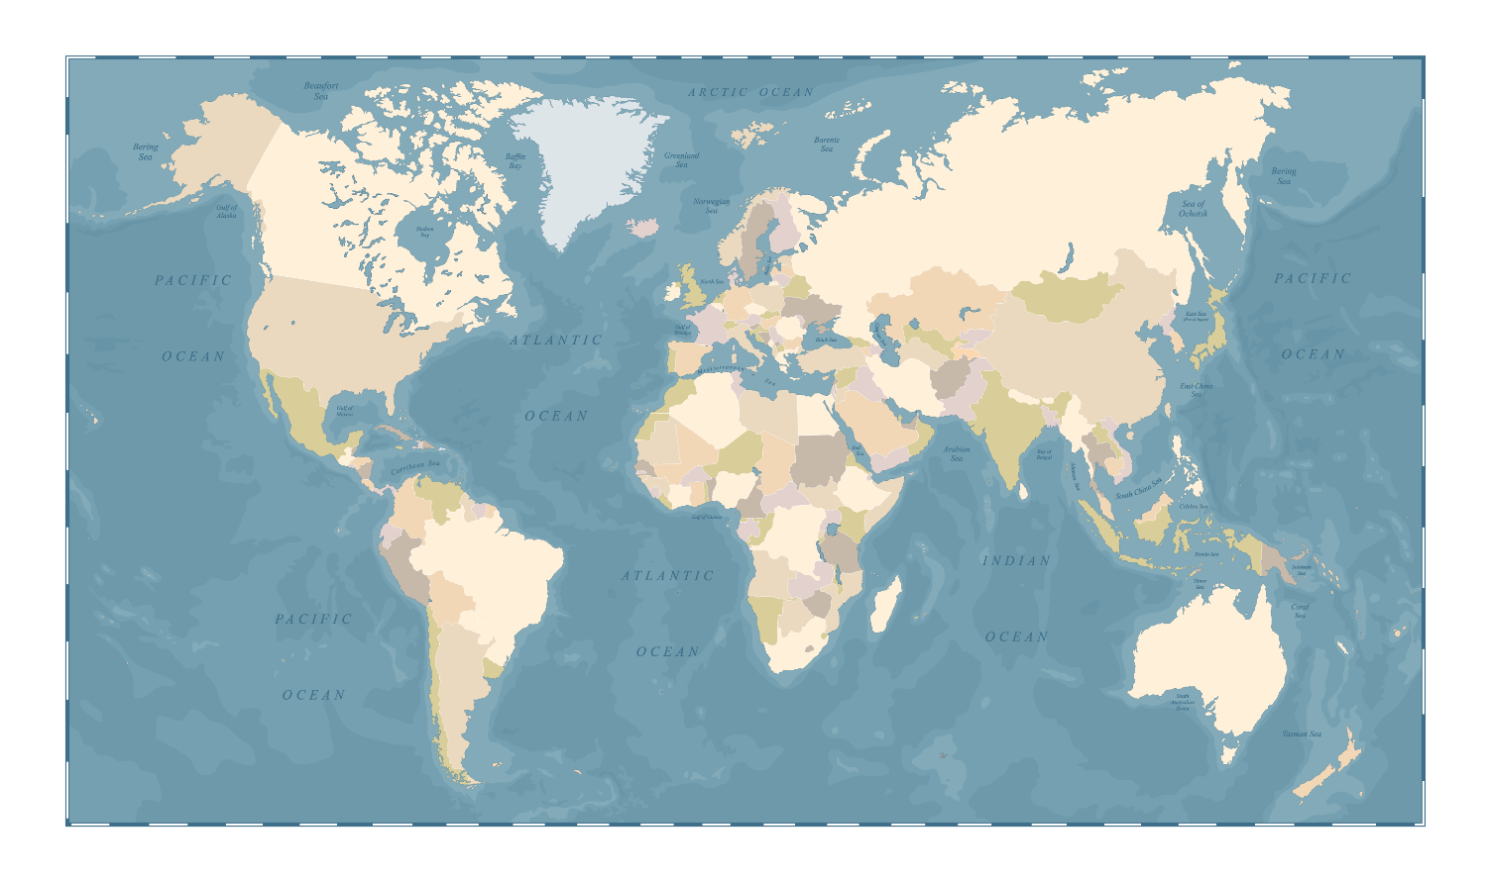

Slide 3
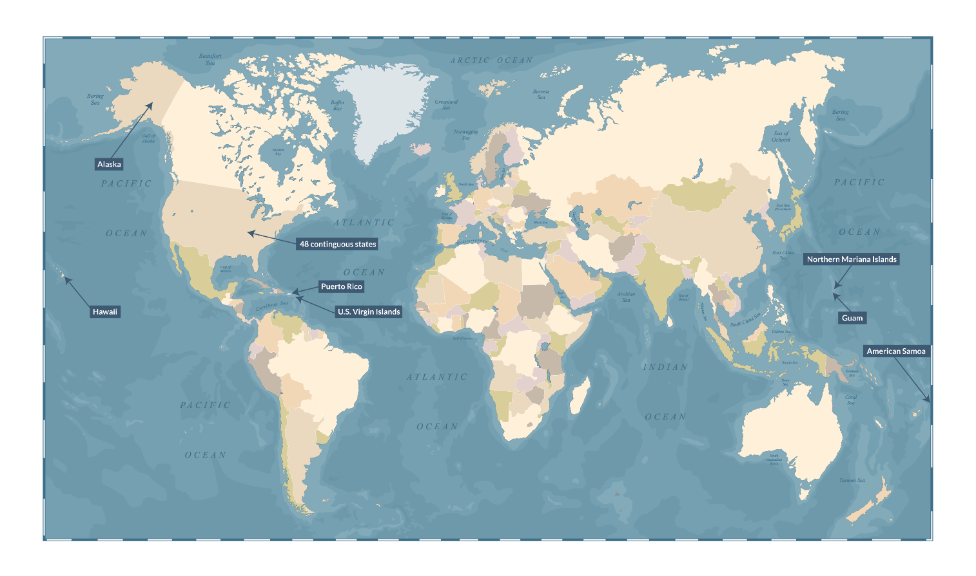
Alaska
48 contiguous states
Northern Mariana Islands
Puerto Rico
Hawaii
U.S. Virgin Islands
Guam
American Samoa

Slide 4
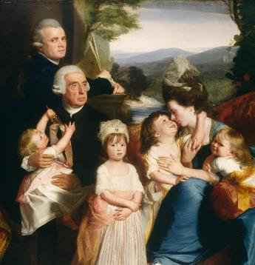
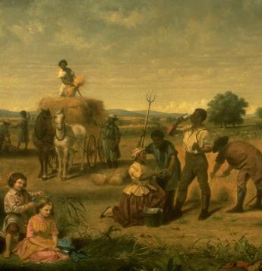
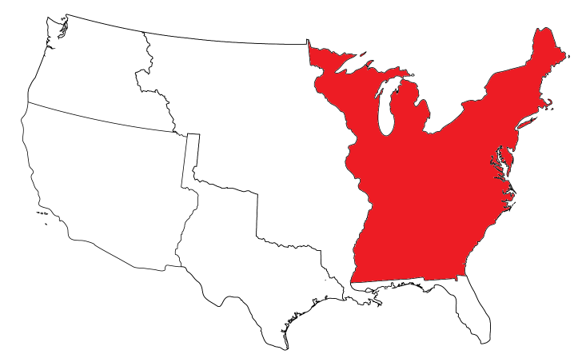
THE ORIGINAL UNITED STATES
1776 – thirteen British colonies declare independence and form the United States of America
1788 – Constitution ratified
1790 – Washington, District of Columbia created
Notes:
Both images are idealized depictions of life in the late 18th century.
Image 1: Copley, John Singleton. The Copley Family. Painting. 1776-1777. Washington, D.C.: National Gallery of Art. https://www.nga.gov/collection/art-object-page.46098.html
Image 2: Stearns, Junius B. Washington as a Farmer. Painting. 1851. Richmond: Virginia Museum of Fine Arts. https://www.vmfa.museum/piction/6027262-8051761/

Slide 5
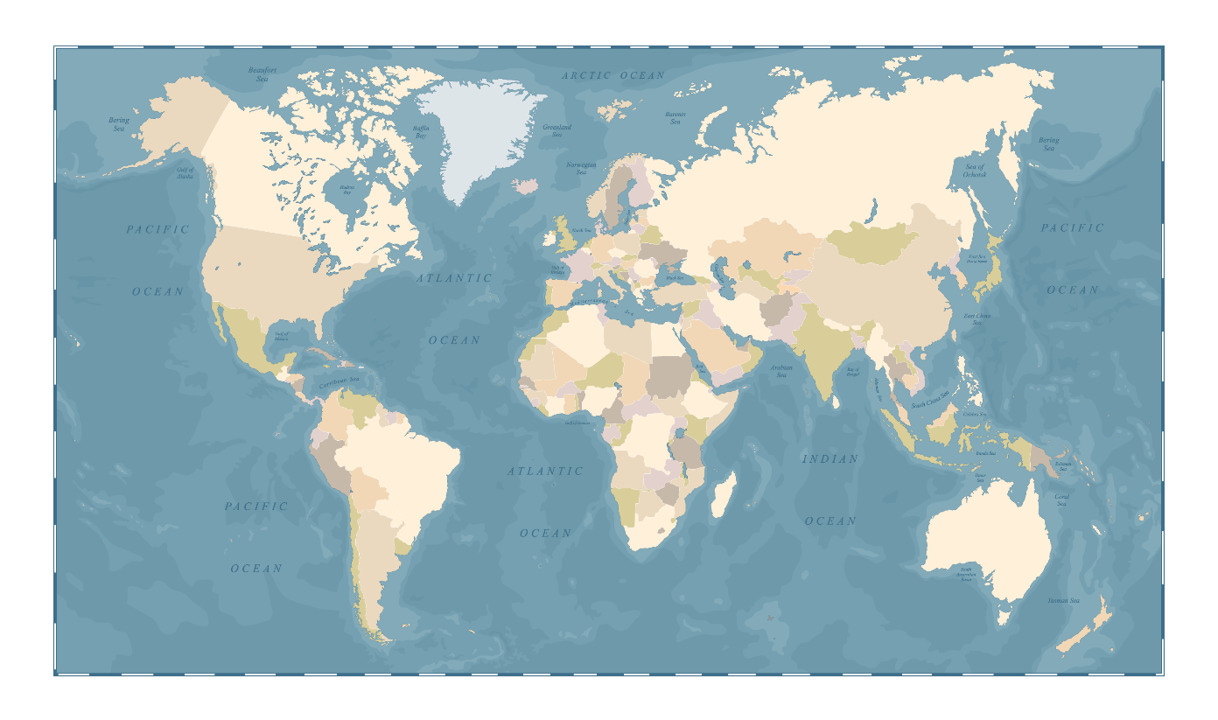
1790 Census
Total Population | 3,929,214
White | 3,172,006
Black | 757,208
Other races not included Estimated fewer than 100,000 Native Americans in this area

Slide 6
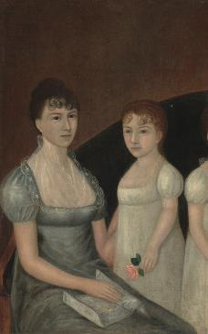
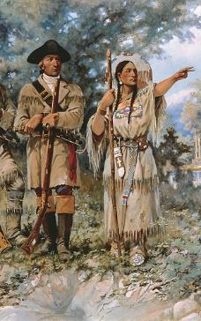
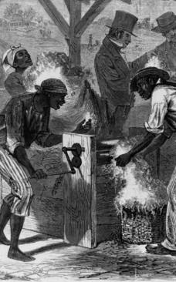
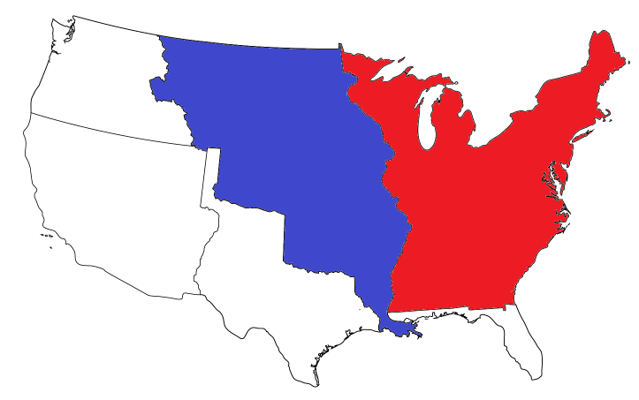
THE LOUISIANA PURCHASE
1700s – Mississippi River controlled by Spain and France
1803 – United States purchases 828,000 square miles of land from France
Notes:
Image 1 shows a well-to-do family in 1800, Image 2 shows Meriwether Lewis and Sacagawea, and Image 3 shows enslaved people using a cotton gin.
Image 1: Johnson, Joshua. Family Group. Painting. 1800. Washington, D.C.: National Gallery of Art. https://www.nga.gov/collection/art-object-page.59883.html
Image 2: Paxson, Edgar S. Lewis and Clark at Three Forks. Painting. 1912. Montana Historical Society. https://mhs.mt.gov/education/Capitol/Art/House-Lobby
Image 3: Sheppard, William L. The First cotton-gin / drawn by William L. Sheppard. Illustration. December 18, 1869. Library of Congress. https://www.loc.gov/item/91784966/

Slide 7
1810 Census
Total Population | 7,239,881
White | 5,862,073
Black | 1,377,808
Other races not included Unknown number of Plains Indians living in this area

Slide 8
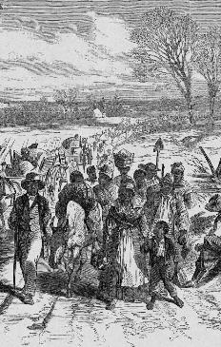
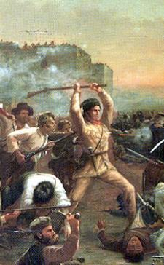
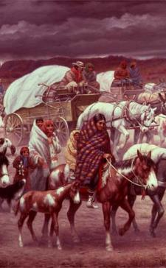
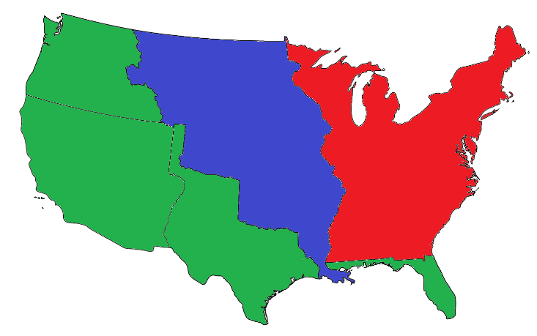
WESTERN EXPANSION
1821 – Spain cedes Florida
1845 – United States annexes Texas
1846 – United States and United Kingdom agree on Oregon Country border
1848 – Mexico cedes land north of Rio Grande river
Native American tribes forced to live on reservations
Notes:
Image 1 shows newly freed slaves heading toward the protection of Union lines during the Civil War, Image 2 shows the Battle of the Alamo, and Image 3 shows Cherokee people during the Trail of Tears.
Image 1: The effects of the proclamation - freed Negroes coming into our lines at Newbern, North Carolina. Illustration. 1863. Library of Congress. https://www.loc.gov/item/95501775/
Image 2: Onderdonk, Robert Jenkins. Fall of the Alamo. Painting. 1903. Texas Governor’s Mansion. Available on Wikimedia. https://commons.wikimedia.org/wiki/File:FalloftheAlamo.jpg
Image 3: Lindneux, Robert. The Trail of Tears. Painting. 1942. Woolaroc Museum. PBS. https://www.pbs.org/wgbh/aia/part4/4h1567.html

Slide 9
1850 Census
Total Population | 23,191,876
Non-Hispanic White | 19,553,068
Black | 3,638,808
Hispanic | 116,943
Other races not included

Slide 10
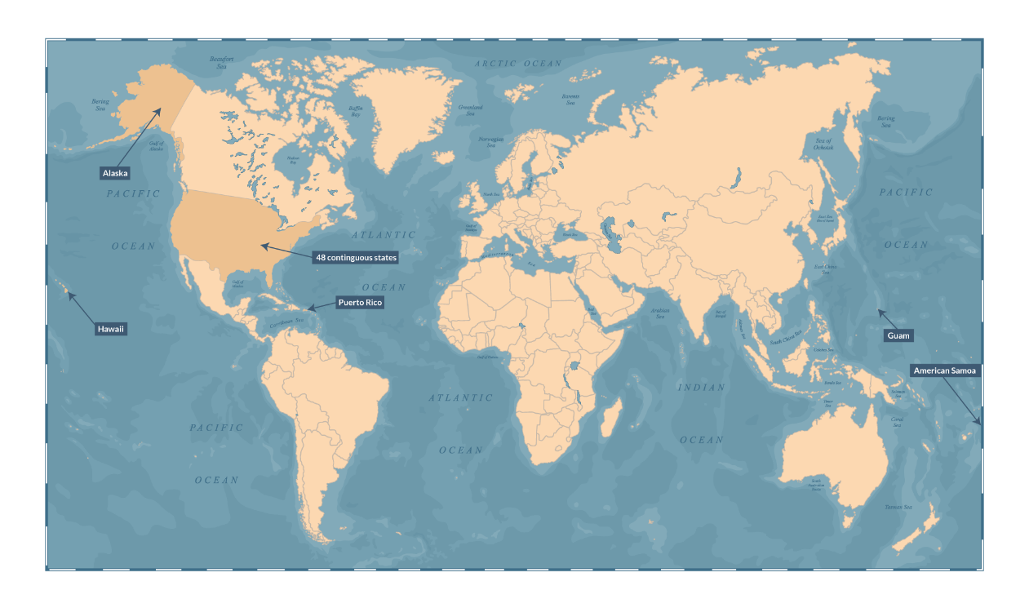
WORLDWIDE EXPANSION
1867 – United States purchases Alaska from Russia
1898 – United States annexes Hawaii
1899 – Spain cedes Guam and Puerto Rico, sells the Philippines for $20 million (granted independence in 1946)
1900 – United States annexes American Samoa
Alaska
48 contiguous states
Puerto Rico
Hawaii
Guam
American Samoa

Slide 11
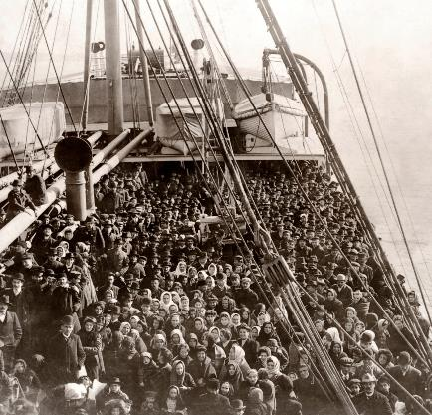
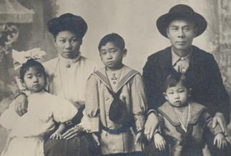
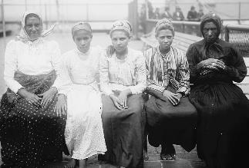
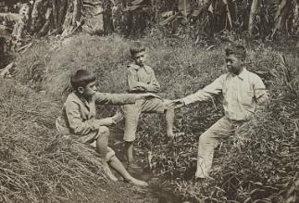

1900 Census
Total Population | 75,994,575
Non-Hispanic White | 66,809,196
Black | 8,833,994
American Indian, Eskimo, and Aleut | 237,196
Asian and Pacific Islander | 114,189
Hispanic | 503,189
Notes:
Image 1 shows a ship arriving at Ellis Island with European immigrants, Image 2 shows a Chinese immigrant family, Image 3 shows a group of newly arrived immigrants at Ellis Island, and Image 4 shows a group of children in Hawaii.
Image 1: Levick, Edwin. Immigrants on an Atlantic Liner. Photograph. December 10, 1906. Library of Congress. https://www.loc.gov/item/97501073/
Image 2: [RS 27464, Chin Quan Chan; Seattle District, Chinese Exclusion Act Case Files, Applications to Reenter, c. 1892-1900]: Chin Quan Chan Family, Chinese Exclusion Act Case File, circa 1911,. Photograph. National Archives. https://catalog.archives.gov/id/5585730
Image 3: Immigrants, Ellis Island. Photograph. Bain News Service. Library of Congress. https://www.loc.gov/item/2014681556/
Image 4: The Hawaiian boys may have their bananas plentiful and fresh. Photograph. 1902. Library of Congress. https://www.loc.gov/item/2018647353/

Slide 12
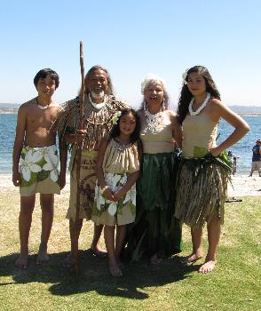


THE UNITED STATES TODAY
1917 – United States purchases U.S. Virgin Islands from Denmark
1978 – Northern Mariana Islands formally governed by United States
Alaska
48 contiguous states
Northern Mariana Islands
Puerto Rico
Hawaii
U.S. Virgin Islands
Guam
American Samoa
Notes:
Image shows a family from Guam dressed in traditional clothing at a festival.
Image 1: Sourgose, Marilyn. Kutturan Chamoru Performers (KCP) at the 2010 Pacific Islander Festival Association in San Diego. Photograph. September 25, 2010. Originally posted to Flickr https://flic.kr/p/8EekXT, also available on Wikimedia https://commons.wikimedia.org/wiki/File:Chamorro_performers.jpg

Slide 13
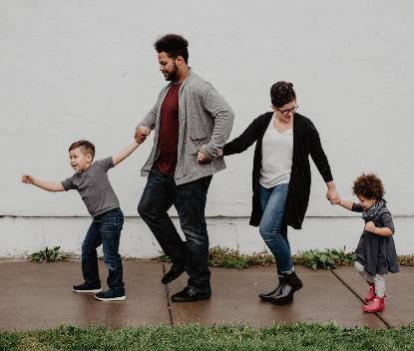




2010 Census
Total Population | 308,745,538
Non-Hispanic White | 196,817,552
Black | 38,929,219
American Indian, Eskimo, and Aleut | 2,932,248
Asian and Pacific Islander | 15,214,265
Some Other Race | 19,107,368
Two or More Races | 9,009,073
Hispanic | 50,774,594
Notes:
Images show groups of American children.
Slide 13: Bauso, Emma. Family Of Four Walking At The Street. Photograph. April 30, 2019. https://www.pexels.com/photo/family-of-four-walking-at-the-street-2253879/
Slide 13: Girls on White Red Jersey Playing Hand Game. Photograph. April 27, 2007. Pixabay. https://www.pexels.com/photo/girls-on-white-red-jersey-playing-hand-game-163465/
Slide 13: Boy in Green Sweater Writing on White Paper. Photograph. March 23, 2020. CDC. https://www.pexels.com/photo/boy-in-green-sweater-writing-on-white-paper-3992949/
Slide 13: Untitled. Photograph. March 24, 2020. CDC. https://www.pexels.com/photo/lunch-kids-student-cafeteria-3997717/
Slide 13: Wilcox, Kat. Four Men Sitting on Platform. Photograph. September 16, 2017. https://www.pexels.com/photo/four-men-sitting-on-platform-923657/

Slide 14
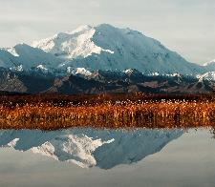
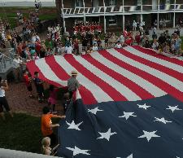
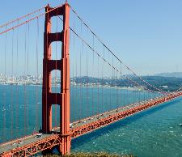
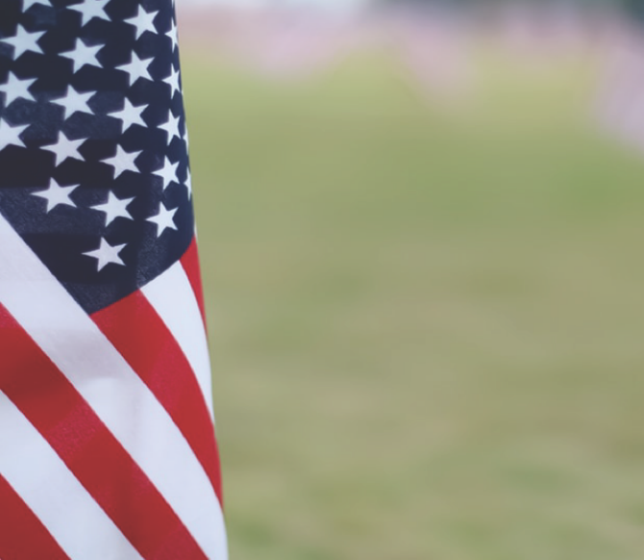
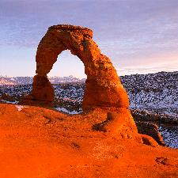
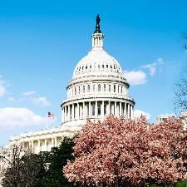
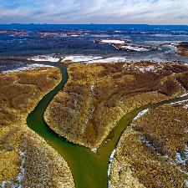

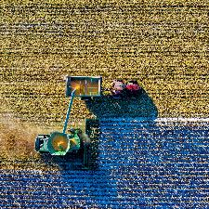
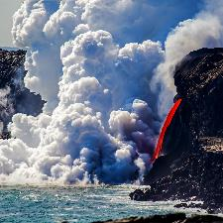
WHAT IS AMERICA?
The United States of America
1 Federal District
50 States
9 Uninhabited Islands
5 Territories
One Federal Government
Notes:
Images show a variety of American landscapes.
Slide 14: Rains, Tim. Denali, Fall. Photograph. January 11, 2011. Denali National Park. National Park Service. https://flic.kr/p/aS1CAB
Slide 14: Flag Change. Photograph. Fort McHenry National Monument and Historic Shrine. National Park Service. https://www.nps.gov/media/photo/gallery-item.htm?pg=912388&id=26D9A904-1DD8-B71B-0B2D528AB4559EE8&gid=1C27E1E2-155D-451F-6739965D63726B10
Slide 14: Golden Gate Bridge. Photograph. September 8, 2014. https://www.pexels.com/photo/america-architecture-bay-boat-208745/
Slide 14: Drum, Neal Herbert. Delicate Arch. December 2003. Arches National Park. National Park Service. https://flic.kr/p/aYrb7V
Slide 14: Highsmith, Carol. U.S. Capitol building, Washington, D.C. Photograph. Library of Congress. https://www.loc.gov/item/2011630770/
Slide 14: Fisk, Tom. Aerial Photography of River. Photograph. November 23, 2018. https://www.pexels.com/photo/aerial-photography-of-river-1629803/
Slide 14: Pilger, Kai. People in Train Station during Day. Photograph. May 20, 2017. https://www.pexels.com/photo/american-flag-architecture-blur-bright-414530/
Slide 14: Fisk, Tom. Top View of Green Field. Photograph. November 14, 2018. https://www.pexels.com/photo/top-view-of-green-field-1595104/
Slide 14: Wei, Janice. Lava "firehose" enters ocean at Kamokuna in Hawaii Volcanoes NP. Photograph. January 3, 2017. Hawaii Volcanoes National Park. National Park Service. https://flic.kr/p/T7JXVb

