Slide 1

Tuskegee Airmen
ARLINGTON NATIONAL CEMETERY HISTORY EDUCATION SERIES
Notes:
Ask: Who were the Tuskegee Airmen? What did they do?
Class Brainstorm: Why is it important for a military to have an air force or air corps?
Answers may include: for reconnaissance, transportation, bombing missions, air-to-air combat, support of land troops
Class Brainstorm: Why was it important for the military to strengthen the U.S. Army Air Corps during World War II?
Discussion may include following ideas:
• Technological advancements in the early 20th century made air power an increasingly decisive factor in combat
• Aviators supported land invasions by assuming control of the skies, bombing targets behind enemy lines which also required aviators to serve as escorts, and conducting reconnaissance and surveillance missions
• United States was geographically isolated from Pacific and European theaters and needed air power to transport troops, equipment, and supplies

Slide 2
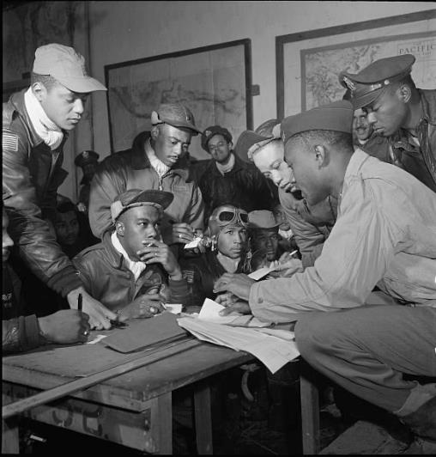
BACKGROUND
From 1941-1946, 996 African American pilots completed training in Tuskegee, Alabama
355 served overseas during World War II
84 lost their lives
Despite segregation and discrimination, Tuskegee Airmen served with distinction
1945 photo of Tuskegee airmen at Ramitelli Airfield in Italy. (LOC)
ARLINGTON NATIONAL CEMETERY HISTORY EDUCATION SERIES
Notes:
The Tuskegee Airmen are one of the most famed groups of African American military personnel in history. From 1941 to 1946, 996 African American pilots completed their training in Tuskegee, Alabama – 355 saw service overseas during World War II, with 84 losing their lives. Despite facing segregation and discrimination, the Tuskegee Airmen provided distinguished service to the United States and many were, and continue to be, recognized and celebrated for their skills and valor. A number of Tuskegee Airmen are buried at Arlington National Cemetery and there are several parks and exhibits dedicated to their memory nationwide.
Photo: Frissell, Toni. [Photograph of several Tuskegee airmen at Ramitelli, Italy, March 1945]. Photograph. March 1945. Library of Congress. https://www.loc.gov/item/2007675064/

Slide 3
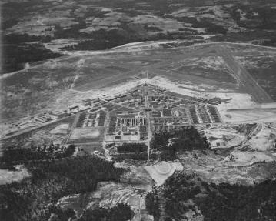



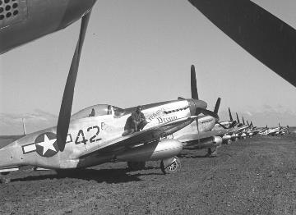
DEFINITIONS
Tuskegee: Tuskegee University a historically Black university, center of training program for African American air personnel during World War II
Army Air Corps organized in 1926, reorganized into Army Air Forces in 1941. U.S. Air Force created in 1947.
Logos of the Army Air Corps, Army Air Forces (U.S. Army), and U.S. Air Force. (U.S. Air Force)
Aerial view of Tuskegee Army Airfield. (Maxwell Air Force Base/1944)
Squadron: basic unit of air forces, composed of pilots and flight crews
Group: three to four flying squadrons
1945 photo of planes used by the Tuskegee Airmen in Italy. (LOC)
ARLINGTON NATIONAL CEMETERY HISTORY EDUCATION SERIES
Notes:
To define a few terms used throughout the lesson:
Tuskegee: Tuskegee University is a historically Black university, founded in 1881. The U.S. government had begun funding a Civilian Pilot Training Program at Tuskegee in 1939, and in 1941 the War Department began building a military airfield near the university. Tuskegee became the training center of all African American air personnel during World War II.
Photo: Aerial view of Tuskegee Army Air Field from an altitude of 4,000 feet. Photograph. Maxwell Air Force Base, AL: Air Force Historical Research Agency, May 8, 1944. National Parks Service. https://www.nps.gov/museum/exhibits/tuskegee/lgimage/air19.htm
Army Air Corps/Army Air Forces/Air Force: The U.S. Army Air Corps was organized in 1926. To allow for more administrative control, it was reorganized as the Army Air Forces in 1941. In 1947, the U.S. Air Force was created as an independent service branch within the United States military.
Illustration: Logo of Army Air Corps. Illustration. U.S. Army. https://www.army.mil/aviation/aircorps/index.html
Illustration: Logo of Army Air Forces. Illustration. U.S. Army. https://www.army.mil/aviation/airforces/index.html
Illustration: Department of the Air Force Logo-GIF. Illustration. U.S. Air Force. https://www.af.mil/News/Art/igphoto/2001275686/
Squadron: basic unit of air forces, composed pilots and flight crews
Group: primary combat unit of the Army Air Forces, consisting of three to four squadrons
Photo: Frissell, Toni. [An unidentified Tuskegee airman sitting on a P-5/D, "Creamer's Dream" airplane, Ramitelli, Italy, March 1945]. Photograph. March 1945. Library of Congress. https://www.loc.gov/item/2017646151/

Slide 4
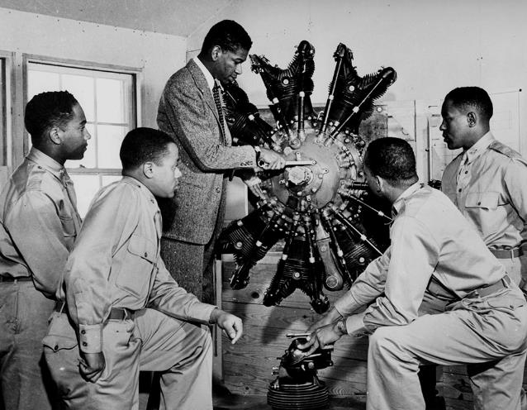
BEGINNINGS
Prior to World War II, military had barred African Americans from becoming pilots, though African American men and women had been distinguishing themselves as pilots for decades
Pressure from African American newspapers and civil rights leaders led War Department to form an all-Black pursuit squadron
Army selected Tuskegee University as site for African American military pilot training
Tuskegee airmen examining an aircraft engine during training. (Maxwell Air Force Base)
ARLINGTON NATIONAL CEMETERY HISTORY EDUCATION SERIES
Notes:
The emergence of aviation as a technological and cultural phenomenon in the early twentieth century afforded special prestige to civilian and military aviators. Before World War II, the military barred African Americans from enlisting in the Army Air Corps, as high-ranking officers in the military perpetuated the belief that African Americans lacked the necessary skills to serve as military aviators. However, African American men and women actively challenged this perception by earning their pilot’s license and forming flying clubs that sponsored air shows.
After intense pressure by prominent African American newspapers and civil rights leaders, the War Department, the predecessor to the Department of Defense, announced their intention to form a “Negro pursuit squadron” on January 16, 1941. In June of 1941, the War Department selected Tuskegee University, a historically Black university in Alabama, as the site for training. From 1941 to 1946, 996 African American pilots completed training in Tuskegee.
Photo: Aviation cadets study a radial aircraft engine during one of their ground school courses. Photograph. Maxwell Air Force Base, AL: Air Force Historical Research Agency, June 1942. National Parks Service. https://www.nps.gov/museum/exhibits/tuskegee_airmen/planes_pilots/TA093_AviationCadets_RadialEngine_MaxwellAFB.html

Slide 5
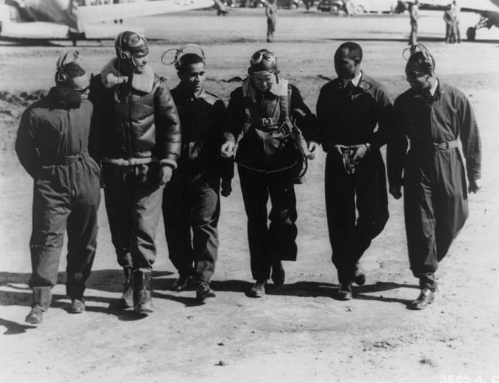
BEGINNINGS
March 1942 – Benjamin O. Davis Jr. graduates Tuskegee training program; a few months later assigned to be commanding officer of 99th Pursuit Squadron
April 1943 – 99th Pursuit Squadron deploys to North Africa
June 2, 1943 – 99th Pursuit Squadron flies first combat mission over Mediterranean Sea
July 1943 – 99th Pursuit Squadron provides air support for Allied invasion of Sicily, Italy
1942 photo of the first class of pilots to graduate from the Advanced Flying School at Tuskegee. (LOC)
ARLINGTON NATIONAL CEMETERY HISTORY EDUCATION SERIES
Notes:
One of the first graduates of the training program was Benjamin O. Davis Jr. who earned his wings in March 1942. Later that year he was assigned to be the commanding officer of the 99th Pursuit Squadron.
In April of 1943, the 99th deployed to North Africa, which was at that time a major seat of the war. They flew their first combat mission over the Mediterranean Sea on June 2, 1943 and in July they provided air support for the Allied invasion of Sicily, Italy.
Photo: [First graduating class of African American pilots in U.S. Army Air Corps, at Advanced Flying School, Tuskegee, Alabama: G.S. Roberts, B.O. Davis, C.H. DeBow, R.M. Long, Mac Ross, and L.R. Curtis]. Photograph. March 7, 1942. Library of Congress. https://www.loc.gov/item/92521044/

Slide 6
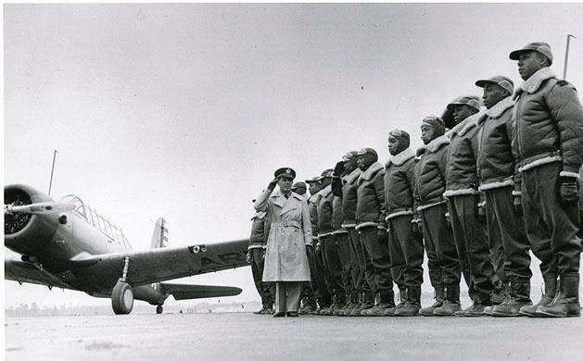
EXPERIENCING RACISM
Military services and facilities remained segregated
Racism in Alabama made it dangerous for African American cadets to go into town
White Tuskegee residents petitioned to block Army’s plan to build airfield dedicated to training African Americans
Tuskegee Airmen given worn down aircraft and success in combat was underreported
Maj. James A. Ellison, commander of the Tuskegee Army Flying School, reviews the first class of Tuskegee Airmen. (U.S. Air Force)
ARLINGTON NATIONAL CEMETERY HISTORY EDUCATION SERIES
Notes:
Though African Americans were eligible to enlist as military aviators, the facilities and services of the military remained segregated, and the men who participated in the program faced several challenges during their training.
Racism and restrictive Jim Crow laws in Alabama made it dangerous for African American cadets to venture around the city of Tuskegee. White residents of the town petitioned their senators to block the Army’s plan to build an airfield dedicated to training African Americans.
The Tuskegee Airmen were also given worn down aircraft and reports of their service were sometimes manipulated to make it appear they were less successful in battle than squadrons with white pilots.
Photo: Maj. James A. Ellison, commandant of the Tuskegee Army Flying School, returns the salute of Mac Ross, one of the first graduates, as he passes down the line during review of the first class. Photograph. U.S. Air Force. https://www.af.mil/About-Us/The-Book/Duty-Badges/igphoto/2000569176/mediaid/55646/

Slide 7
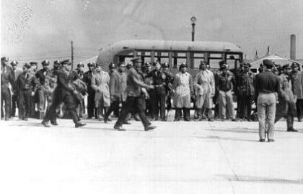
EXPERIENCING RACISM
477th Bombardment Group stationed at Freeman Field, Indiana in 1945
White commanding officers demoted African American officers to “trainees” in order to deny access to new Officer’s Club
April 5, 1945 – group of African American officers challenged policy by walking into club; arrested the next day
Weeks later, Army Chief of Staff ordered that they be released
White commanding officer replaced by Colonel Benjamin O. Davis Jr.
1945 photo of the review of African American officers during the incident at Freeman Field. (LOC)
ARLINGTON NATIONAL CEMETERY HISTORY EDUCATION SERIES
Notes:
Despite these challenges, the Tuskegee Airmen stationed in the United States actively confronted the racists policies of the military.
One incident involved the 477th Bombardment Group, an all-Black unit activated in 1944. In 1945, the 477th was stationed at Freeman Field in Indiana, which had segregated public facilities. White commanding officers at the base demoted African American officers to “trainees” and then used this as grounds to deny them access to a newly renovated Officer’s Club. On April 5, 1945, a group of African American officers decided to challenge this policy and walked into the club. The next day they were all arrested.
News of this injustice spread through the press and even reached the U.S. Congress, and a few weeks later the Army Chief of Staff ordered that the officers be released. As a result of the incident, the white commanding officer of the 477th was replaced by Colonel Benjamin O. Davis Jr.
Photo: [Review of officers during the Freeman Field mutiny, Freeman Field, Indiana]. Photograph. April 1945. Library of Congress. https://www.loc.gov/item/2004681714/

Slide 8
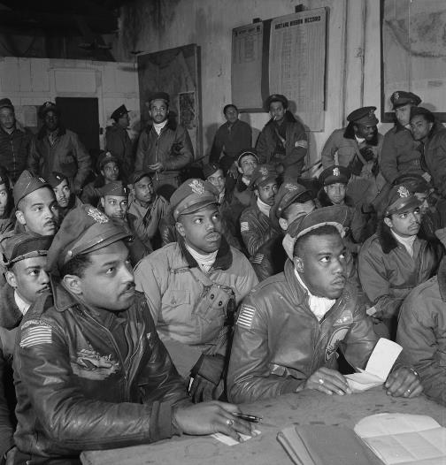
COMBAT EXPERIENCE
99th Fighter Squadron – flew patrol missions across the Mediterranean Sea, provided aerial support for infantry in Italy
332nd Fighter Group – patrolled southern coasts of Italy, escorted bombers on long-range missions
In total, Tuskegee Airmen flew almost 1600 missions, destroyed over 100 enemy aircraft in the air and 150 on the ground
Earned many awards, including Distinguished Unit Citations, Silver Star, Bronze Star, Air Medal, and Purple Heart
1945 photo of Tuskegee Airmen in a briefing at Ramitelli Airfield in Italy. (LOC)
ARLINGTON NATIONAL CEMETERY HISTORY EDUCATION SERIES
Notes:
Throughout WWII, the Tuskegee Airmen proved that African Americans could capably serve as military aviators.
When first deployed to North Africa, the 99th Fighter Squadron (formerly 99th Pursuit Squadron) flew patrol missions across the Mediterranean Sea, and while stationed in Italy they provided aerial support for American infantry troops. The 332nd Fighter Group patrolled the southern coasts of Italy and escorted bomber planes on long-range missions.
During their service, the Tuskegee Airmen flew almost 1600 missions. They destroyed over 100 enemy aircraft in the air, as well as 150 more on the ground. They earned three Distinguished Unit Citations, and individual pilots received several awards, to include the Silver Star, the Bronze Star, the Air Medal, and the Purple Heart.
Photo: Frissell, Toni. [Members of the Army Air Force 332nd Fighter Group in a briefing room, Ramitelli, Italy]. Photograph. March 1945. Library of Congress. https://www.loc.gov/item/2016645635/

Slide 9
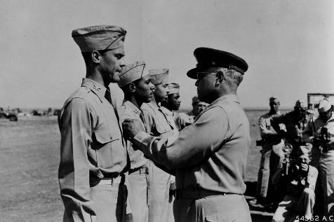
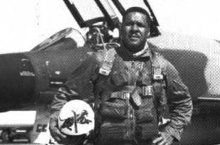
NOTABLE MEMBERS
Benjamin O. Davis Jr.
Commanded 99th Fighter Squadron, 332nd Fighter Group and 477th Composite Group; became the first African American general in the U.S. Air Force in 1954
1944 photo of General Benjamin O. Davis Sr. pinning the Distinguished Flying Cross on his son, Lt. Col. Benjamin O. Davis Jr. (Maxwell Air Force Base)
Daniel “Chappie” James Jr.
Became the first African American four-star general in the U.S. Air Force in 1975
Vietnam War-era photo of Daniel “Chappie” James Jr. (Smithsonian)
ARLINGTON NATIONAL CEMETERY HISTORY EDUCATION SERIES
Notes:
Benjamin O. Davis Jr.
Davis began his Army career as an infantry officer, but entered the Advanced Flying School at Tuskegee in 1941 and graduated with his pilot wings in 1942. During World War II, Davis commanded the 99th Fighter Squadron, 332nd Fighter Group and 477th Composite Group. He received a Silver Star and a Distinguished Flying Cross for his heroic actions in Europe. When President Truman released his plan to integrate the military forces, Davis helped draft a plan to implement the order within the Air. In 1954, Davis became the first African American general in the U.S. Air Force (following in the footsteps of his father, who was the first African American general in the U.S. Army). Davis is interred at Arlington National Cemetery.
Photo: General Benjamin O. Davis pins the Distinguished Flying Cross on his son, Lt. Col. Benjamin O. Davis, Jr. at Ramitelli Airfield, Italy. Photograph. Maxwell Air Force Base, AL: Air Force Historical Research Agency, September 1944. National Parks Service. https://www.nps.gov/museum/exhibits/tuskegee_airmen/selected_individuals/Benjamin_Davis/TUSK041.html
Daniel “Chappie” James Jr.
James had already completed the Civilian Pilot Training Program at Tuskegee and was a civilian instructor pilot for the Army Air Corps before he went through the program as a cadet, graduating in 1943. James was not assigned overseas during World War II, but he flew 101 combat missions during the Korean War and 78 combat missions during the Vietnam War. On September 1, 1975 James was assigned as Commander in Chief of North American Air Defense Command and became the first African American four-star general in the U.S. Air Force. James is interred at Arlington National Cemetery.
Photo: Daniel “Chappie” James Jr. with his McDonnell Douglas F-4C Phantom during the Vietnam War. Photograph. Smithsonian. https://airandspace.si.edu/multimedia-gallery/6549hjpg

Slide 10
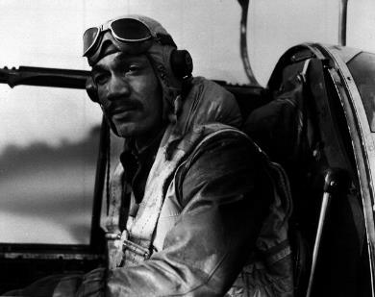
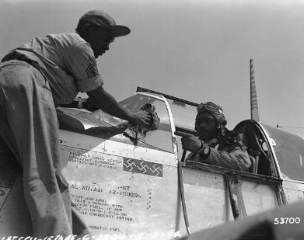
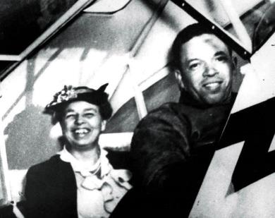
NOTABLE MEMBERS
World War II-era photo of Lee Archer. (Smithsonian)
World War II-era photo of Clarence Lester. (Smithsonian)
1940 photo of Eleanor Roosevelt and C. Alfred Anderson. (Smithsonian)
Lee “Buddy” Archer
Flew 169 combat missions across 11 countries; shot down three German fighters during one mission
Clarence D. “Lucky” Lester
Flew 90 combat missions; shot down three German fighters during one mission
C. Alfred “Chief” Anderson
Chief flight instructor of Tuskegee Airmen
ARLINGTON NATIONAL CEMETERY HISTORY EDUCATION SERIES
Notes:
Lee “Buddy” Archer
Archer graduated first in his class from the Tuskegee training program in 1943, and was assigned to the 302nd Fighter Squadron of the 332nd Fighter Group. During World War II he flew 169 combat missions across 11 countries and earned the Distinguished Flying Cross. His most famous mission was on October 12, 1944, when he shot down three German fighters over Hungary within 10 minutes. He later flew missions during the Korean War and retired from the military in 1970 with the rank of lieutenant colonel. Archer is interred at Arlington National Cemetery.
Photo: Lee A. Archer. Photograph. Smithsonian. https://airandspace.si.edu/multimedia-gallery/99-15459640jpg?id=3001
Clarence D. “Lucky” Lester
Lester completed 90 combat missions during World War II. During one famous mission on July 18, 1944 over northern Italy, Lester shot down three enemy aircraft. He remained in the military until his retired in 1969 with the rank of colonel. Lester is interred at Arlington National Cemetery.
Photo: “Lucky” Lester. Photograph. Smithsonian. https://airandspace.si.edu/multimedia-gallery/99-15470640jpg?id=3015
C. Alfred “Chief” Anderson
Anderson earned his pilot’s license in 1929, one of the first African Americans to do so. In 1940, he was recruited to be the Chief Civilian Flight Instructor at Tuskegee, and in 1941 he became the Chief Instructor for aviation cadets of the 99th Pursuit Squadron. When first lady Eleanor Roosevelt toured Tuskegee in 1941, Anderson took her for a flight around the campus. This event attracted a lot of positive attention for the aviation program at Tuskegee and the skills of African American pilots. In 2014, the United States Postal Service released a stamp featuring a portrait of Anderson.
Photo: “Chief” Anderson took First Lady Eleanor Roosevelt flying. Photograph. 1941. Smithsonian. https://pioneersofflight.si.edu/content/first-lady-eleanor-roosevelt-and-flight-instructor-c-alfred-%E2%80%9Cchief%E2%80%9D-anderson

Slide 11
LATER YEARS AND LEGACY
July 1, 1947 – 477th Bombardment Group disbanded
September 1947 – 332nd Fighter Group becomes only active African American unit in U.S. Air Force
July 1968 – President Truman orders desegregation of military
July 1, 1949 – 332nd Fighter Group disbanded and squadrons integrated into previously all-white units
Service of Tuskegee Airmen helped pave the way for service of other African American military aviators
1944 photo of Tuskegee Airmen kneeling next to one of their P-51 Mustangs in Italy. (NARA)
ARLINGTON NATIONAL CEMETERY HISTORY EDUCATION SERIES
Notes:
After World War II, the Army Air Forces disbanded the 477th Bombardment Group. When the U.S. Air Force was created in 1947, the 332nd Fighter Group was the only active African American unit. In July 1948, President Truman ordered that the military become integrated and on July 1, 1949, the Air Force disbanded the 332nd Fighter Group and integrated the squadrons into previously all-white units. Individual Tuskegee Airmen continued to serve in the Air Force, many with distinction, and their skill and bravery helped pave the way for African American aviators to serve across all branches of the U.S. armed forces.
Photo: Fliers of a P-51 Mustang Group of the 15th Air Force in Italy "shoot the breeze" in the shadow of one of the Mustangs they fly. Photograph. August 1944. National Archives. https://catalog.archives.gov/id/535843

Slide 12
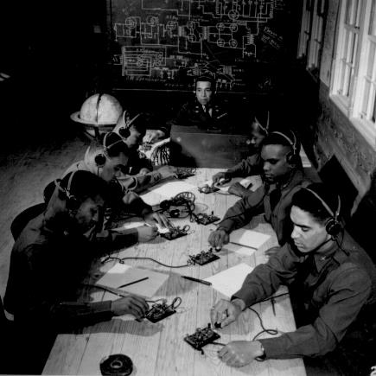
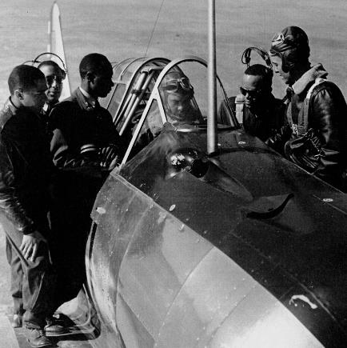
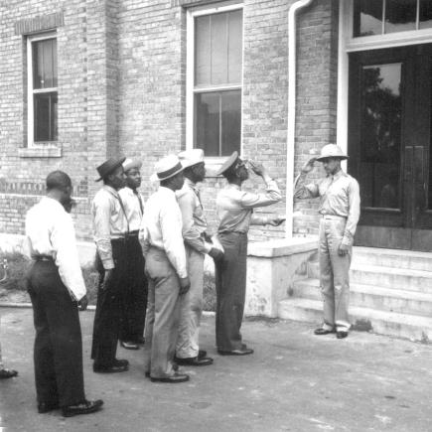
CONNECTIONS
Does the story of the Tuskegee Airmen remind you of anything else you have learned? What connections can you make to your prior knowledge?
The first graduating class of the Advanced Flying School at Tuskegee Army Airfield.
(Maxwell Air Force Base)
Tuskegee airmen learning how to send and receive codes. (NARA)
1941 photo of cadets reporting to Capt. Benjamin O. Davis Jr. at Tuskegee. (NARA)
ARLINGTON NATIONAL CEMETERY HISTORY EDUCATION SERIES
Notes:
Now that you’ve been introduced to the Tuskegee Airmen, what connections can you make to other things you have learned in class?
Photo: "Basic and advanced flying school for Negro Air Corps cadets, Tuskegee, Alabama... In the center is Capt. Roy F. Morse, Air Corps... He is teaching the cadets how to send and receive code.“ Photograph. January 1942. National Archives. https://www.archives.gov/files/research/african-americans/ww2-pictures/images/african-americans-wwii-168.jpg
Photo: The first graduates of the Advanced Flying School on a BT-13 basic training aircraft. Photograph. Maxwell Air Force Base, AL: Air Force Historical Research Agency, ca. 1941-1942. National Parks Service. https://www.nps.gov/museum/exhibits/tuskegee_airmen/training_for_war/TA096_first_graduates_MaxwellAFB.html
Photo: Army Air Corps Cadets report to Capt. Benjamin Oliver Davis, Jr., commandant of cadets, Tuskegee Field, Alabama. Photograph. National Archives: September 1941. National Parks Service. https://www.nps.gov/museum/exhibits/tuskegee_airmen/selected_individuals/Benjamin_Davis/NARA-111-SC-122434-Cadets-BODavis.html

