Slide 1
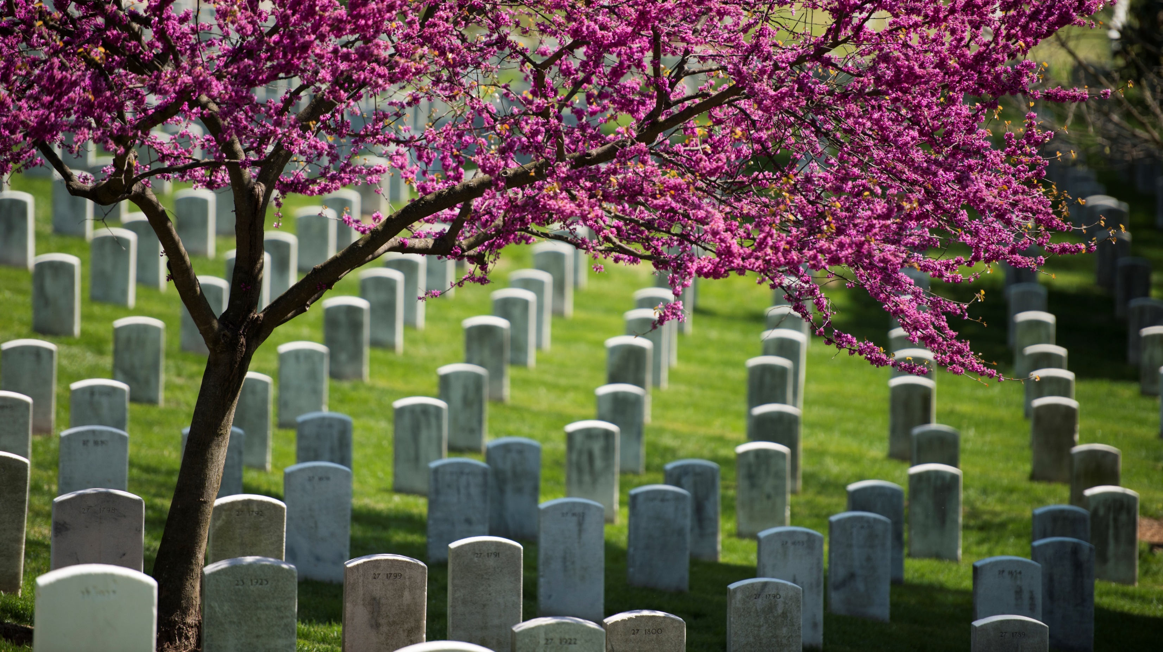
THE FREEDPEOPLE OF SECTION 27
WHAT IS ARLINGTON NATIONAL CEMETERY?
WHO IS BURIED THERE?
ARLINGTON NATIONAL CEMETERY
HISTORY EDUCATION SERIES
Notes:
Lead a discussion about Arlington National Cemetery – what is its purpose? Who is buried there? Responses will vary, but it is most important to establish that Arlington National Cemetery is a military cemetery and it is a greatly honored place in American society.
Share: Though Arlington National Cemetery is a military cemetery, there is actually a section where thousands of African American civilians were buried between 1864-1867.
Ask: Who do you think these people were? Why were they buried at Arlington National Cemetery?
After a few responses, share that in today’s lesson you will be discussing who those people were and what life would have been like for them at that time.
Photo: Larue, Rachel. Spring in Arlington National Cemetery. Photograph. Arlington, Virginia: Arlington National Cemetery, April 15, 2016. https://flic.kr/p/Gi8q1K

Slide 2
SLAVERY AND AFRICAN AMERICAN RIGHTS:
A TIMELINE
1780s
Individual states begin abolishing slavery
Slaves in those states not necessarily immediately freed
1857
Dred Scott v. Sandford
Supreme Court rules African Americans are not citizens
1865
Thirteenth Amendment
Abolishes slavery and involuntary servitude, except as punishment for crime
1870
Fifteenth Amendment
Federal government and states cannot deny citizens the right to vote based on race, color, or previous condition of servitude
1861
Civil War begins
Congress forbids return of escaped slaves to Confederate slaveowners. Escaped slaves considered “contraband.”
1793
Fugitive Slave Act passed
Allowed slaveowners to recover escaped slaves, illegal to assist escaped slaves
1780
1860
1870
1863
Emancipation Proclamation
Slaves in Confederate states freed
1787
U.S. Constitution Drafted
No prohibitions on slavery, slaves count as three-fifths a person when determining representation, slaves who escape to free states are not to be freed
1850
Fugitive Slave Act strengthened
Easier for slaveowners to seize escaped slaves, harsher punishments for assisting escaped slaves
1868
Fourteenth Amendment
Citizenship granted to anyone born or naturalized in the U.S.
Notes:
To get a sense of what it meant to be a “freed person” in the years surrounding the Civil War, let’s look at a timeline of the rights of African Americans in the United States up to that time.
1780s – Northern states began individually banning the slave trade or abolishing slavery, though slaves were not always immediately freed from servitude
1787 – U.S. Constitution drafted, with no prohibitions of slavery, and policy of each slave being counted as three-fifths of a person when determining representation in the House of Representatives and taxes. It also stated that slaves who escaped to free states should not be freed, but instead returned to their enslaver.
1793 – Fugitive Slave Act passed, which allowed slaveowners to recover slaves who escaped to free states and made it a crime to assist escaped slaves
1850 – stricter Fugitive Slave Act passed, with provisions that made it easier for slaveowners to seize escaped slaves and contained harsher punishments for citizens who assisted escaped slaves
1857 – Supreme Court ruling in Dred Scott v. Sandford declared African Americans (free and enslaved) were not American citizens and therefore not due the rights and protections within the U.S. Constitution.
1861 – Civil War began, and slaves escaped to the protection of the Union Army and the North. Congress passed laws declaring Army could confiscate Confederate property – such as slaves – and forbidding the return of slaves to Confederate slaveowners. Escaped slaves were known as “contraband,” and many flocked to Union-held forts and camps.
1863 – President Abraham Lincoln issued Emancipation Proclamation, freeing all slaves in Confederate states. Any slave that could escape to the Union would be free, though slaves in Union slave-owning states (Delaware, Maryland, Kentucky and Missouri) were not yet free.
1865 – Thirteenth Amendment passed, abolishing slavery and involuntary servitude, except as punishment for a crime.
1868 – Fourteenth Amendment passed, granting citizenship to all persons born or naturalized in the United States – including former slaves – and guaranteed all citizens equal protection of the law.
1870 – Fifteenth Amendment passed, prohibiting the federal government and each state from denying a citizen the right to vote based on that person’s “race, color, or previous condition of servitude.”
Despite the provisions of the 13th, 14th, and 15th amendments, many states passed laws known as “Black Codes” that heavily restricted the rights and liberties of African Americans. Even in states that had strongly opposed slavery, many public spaces, institutions, and neighborhoods were segregated and African Americans faced intense discrimination and prejudice.
As you can see, the status of freedpeople was very uncertain in the years surrounding the Civil War, and freedom for African Americans did not mean getting to enjoy the same rights and protections as white people.

Slide 3
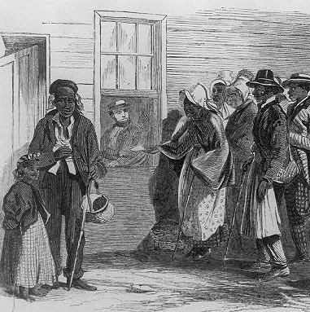
THE FREEDMEN’S BUREAU
United States Army and federal government felt responsible for freedpeople
Bureau of Refugees, Freedmen, and Abandoned Lands (Freedmen’s Bureau) created to assist former slaves
Efforts included building hospitals, supporting education efforts, helping families reunite after the war, and providing legal assistance
Bureau efforts opposed by President Andrew Johnson and others in Congress
1866 illustration of people gathered outside the Freedmen’s Bureau in Richmond, Virginia. (Library of Congress/James E. Taylor)
ARLINGTON NATIONAL CEMETERY HISTORY EDUCATION SERIES
Notes:
Beginning with the sheltering and employment of so-called “contrabands,” the United States Army and federal government felt a degree of responsibility for supporting freedpeople. In March 1865, a few months before the end of the Civil War, the Bureau of Refugees, Freedmen, and Abandoned Lands (commonly known as the Freedmen’s Bureau) was created within the War Department to assist former slaves as they established their new lives as freedpeople. The Freedmen’s Bureau took on a number of tasks, including building hospitals, supporting education efforts, helping families reunite after the war, and providing legal assistance. However, President Andrew Johnson and other white southerners in Congress opposed many of the Bureau’s goals and limited its funding, so it was not as effective as its organizers hoped.
Illustration: Taylor, James E. Glimpses at the Freedmen's Bureau. Issuing rations to the old and sick / from a sketch by our special artist, Jas. E. Taylor. Illustration. Richmond, Virginia, 1866. Library of Congress. https://www.loc.gov/item/2009633700/

Slide 4
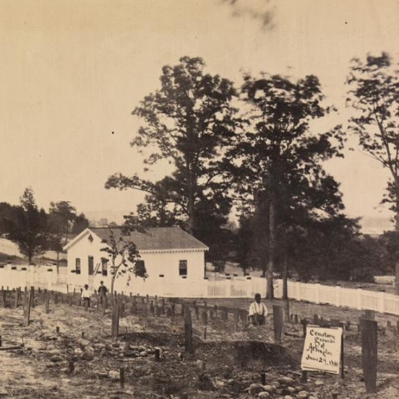
SECTION 27
Government provided burial assistance for poor freedpeople
National cemeteries created to accommodate military burials during Civil War
Burials at Arlington National Cemetery began along northern edge, in today’s Section 27
Contrabands and freedpeople fell under government responsibility and if too poor to afford private burial could be buried in a national cemetery
Civilian burials occurred at ANC from 1864-1867
Photo taken June 29, 1864 of the first graves in Arlington National Cemetery. (Chrysler Museum of Art/Andrew Joseph Russell)
ARLINGTON NATIONAL CEMETERY HISTORY EDUCATION SERIES
Notes:
One of the ways the federal government took responsibility for supporting freedpeople was to provide burial assistance. Depending on a family’s financial needs, this could include just providing a coffin and headstone, assisting with transporting remains to a private burial ground, or burial in a national cemetery.
National cemeteries, including Arlington National Cemetery, were created during the Civil War to accommodate the thousands of Union soldiers who died in battle or in military hospitals. At that time, most families preferred to bury their loved ones in a private cemetery close to home, and national cemeteries were mostly used when the family of a soldier was too poor to afford a proper burial. Since contrabands and freedpeople fell under the care of the federal government through the Army and Freedmen’s Bureau, those who lived and died around Washington, D.C. and were too poor to afford burial in a private cemetery could be buried at Arlington National Cemetery. This only occurred from 1864-1867; after 1867 the cemetery was reserved for military burials.
Photo: Russell, Andrew Joseph. Cemetery at Arlington, Virginia. Photograph. June 29, 1864. Norfolk, Virginia: Chrysler Museum of Art. https://chrysler.emuseum.com/objects/10128/cemetery-at-arlington-virginia

Slide 5
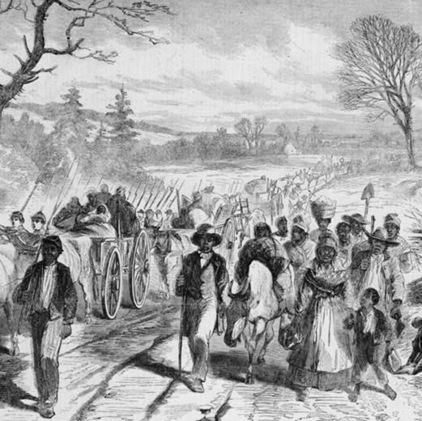
AFRICAN AMERICANS AFTER WAR
Freedpeople had to decide – stay in the South or seek opportunities in the North?
Population of African Americans in Washington, D.C. tripled between
1860-1870
Freedmen’s Bureau built housing to accommodate rise in population
1863 illustration of freedpeople following the Union army in Newbern, North Carolina. (Library of Congress)
ARLINGTON NATIONAL CEMETERY HISTORY EDUCATION SERIES
Notes:
We know very little about the specific lives of the freedpeople buried in Section 27, but let’s discuss what conditions were like for African Americans in general in the years surrounding the Civil War.
As the Union Army marched south, freed slaves had to decide – should they remain where they were, since that was their home and they were more sure of being able to provide food and shelter for their families? Or should they move to the North or West, where they knew they would no longer be slaves, but may not have a place to live or work? In Washington, D.C., the African American population tripled between 1860-1870 as thousands of freedpeople sought protection from the Army and federal government and the opportunity to start a new life.
To accommodate the sudden rise in population, the Freedmen’s Bureau converted Army barracks in Washington D.C. into tenements and operated government farms in Maryland and Virginia where families could live and work. In 1864, a Freedman’s Village and farm were built on land that was later incorporated into Arlington National Cemetery – ironically, the residents of the Freedman’s Village were buried at other cemeteries and are not the freedpeople in Section 27.
Illustration: The effects of the proclamation - freed Negroes coming into our lines at Newbern, North Carolina. Illustration. New Bern, North Carolina, 1863. Library of Congress. https://www.loc.gov/item/95501775/

Slide 6
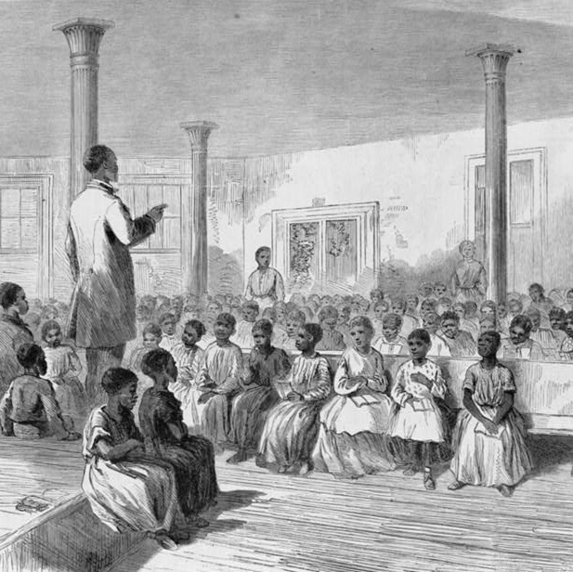
AFRICAN AMERICANS AFTER WAR
Churches became center of African American communities – place to organize for civil rights activism, education efforts, and job training
Highly valued literacy and education
African Americans influential in establishing public school systems and established a number of universities
1866 illustration of an African American school in Charleston, South Carolina. (Library of Congress/Alfred R. Waud)
ARLINGTON NATIONAL CEMETERY HISTORY EDUCATION SERIES
Notes:
Like many white Americans, African Americans throughout the United States built communities centered around churches. Attending church was both a religious and a social activity. Families gathered at church to worship, but also to organize for civil rights activism, education efforts, and job training.
African Americans also highly valued literacy and education. Many African American communities worked with the Freedmen’s Bureau and Northern aid societies to build schools and recruit teachers, and African American voters and legislators advocated for some of the first public school systems in the United States. A number of universities for African Americans were also established, including Washington, D.C.’s Howard University in 1867, named after General Oliver Otis Howard, the Commissioner of the Freedmen’s Bureau.
Illustration: Waud, Alfred R. "Zion" school for colored children, Charleston, South Carolina / from a sketch by A.R. Waud. Illustration. Charleston, South Carolina, 1866. Library of Congress. https://www.loc.gov/item/97501517/

Slide 7
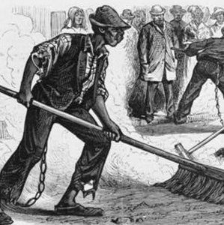
DISCRIMINATION AND PREJUDICE
Schools, hospitals, churches, public transportation, and neighborhoods segregated
Black Codes restricted African American rights and targeted them for arrest
Convicted African Americans forced back into unpaid hard labor
Forcible apprenticeship laws allowed children to be taken from parents and apprenticed to former slaveowners
Freedmen’s Bureau attempted to legally assist
1877 illustration of convicts cleaning the streets of Richmond, Virginia. (Library of Congress)
ARLINGTON NATIONAL CEMETERY HISTORY EDUCATION SERIES
Notes:
Though slavery had been abolished, African Americans still faced intense discrimination and prejudice. Institutions such as schools, hospitals, and churches were segregated, as well as public transportation systems and neighborhoods. Individual states passed laws known as Black Codes that restricted the rights of African Americans and made them easy targets for arrest. Since the 13th Amendment still allowed for slavery and involuntary servitude as punishment for a crime, many African Americans were forced back into unpaid hard labor for “crimes” as minor as not having a job or being outside at night. Several states also had policies of “forcible apprenticeship,” which allowed former slaveowners to retain African American children as “apprentices” if their parents were impoverished. The Freedmen’s Bureau maintained records of assaults committed against freedpeople and assisted with legal advocacy for African Americans, but it would be many years before African Americans would receive equal standing under the law.
Illustration: Preparing for the reception of the president. The chain gang convicts cleaning the streets of Richmond. Illustration. Richmond, Virginia, 1877. Library of Congress. https://www.loc.gov/item/94502949/

Slide 8

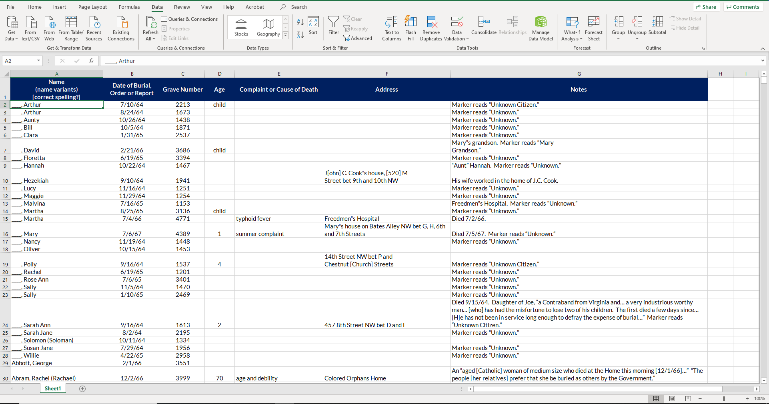
SECTION 27 BURIAL RECORD
Data can provide insights, even though record is incomplete
ARLINGTON NATIONAL CEMETERY HISTORY EDUCATION SERIES
Notes:
The burial records available for those buried in Section 27 of Arlington National Cemetery can also give some insight into what life was like specifically for the poorest freedpeople living in and around Washington, D.C. It should be noted that these records are incomplete and may have errors, as remains were sometimes moved and grave markers replaced multiple times, and cemetery administrators did not prioritize records management for poor civilians.
On the record spreadsheet, there are columns for the name of the deceased, date of death or burial, grave number, age, complaint or cause of death, address where the body was picked up for burial, and additional notes. Not all records have an entry in each column.

Slide 9
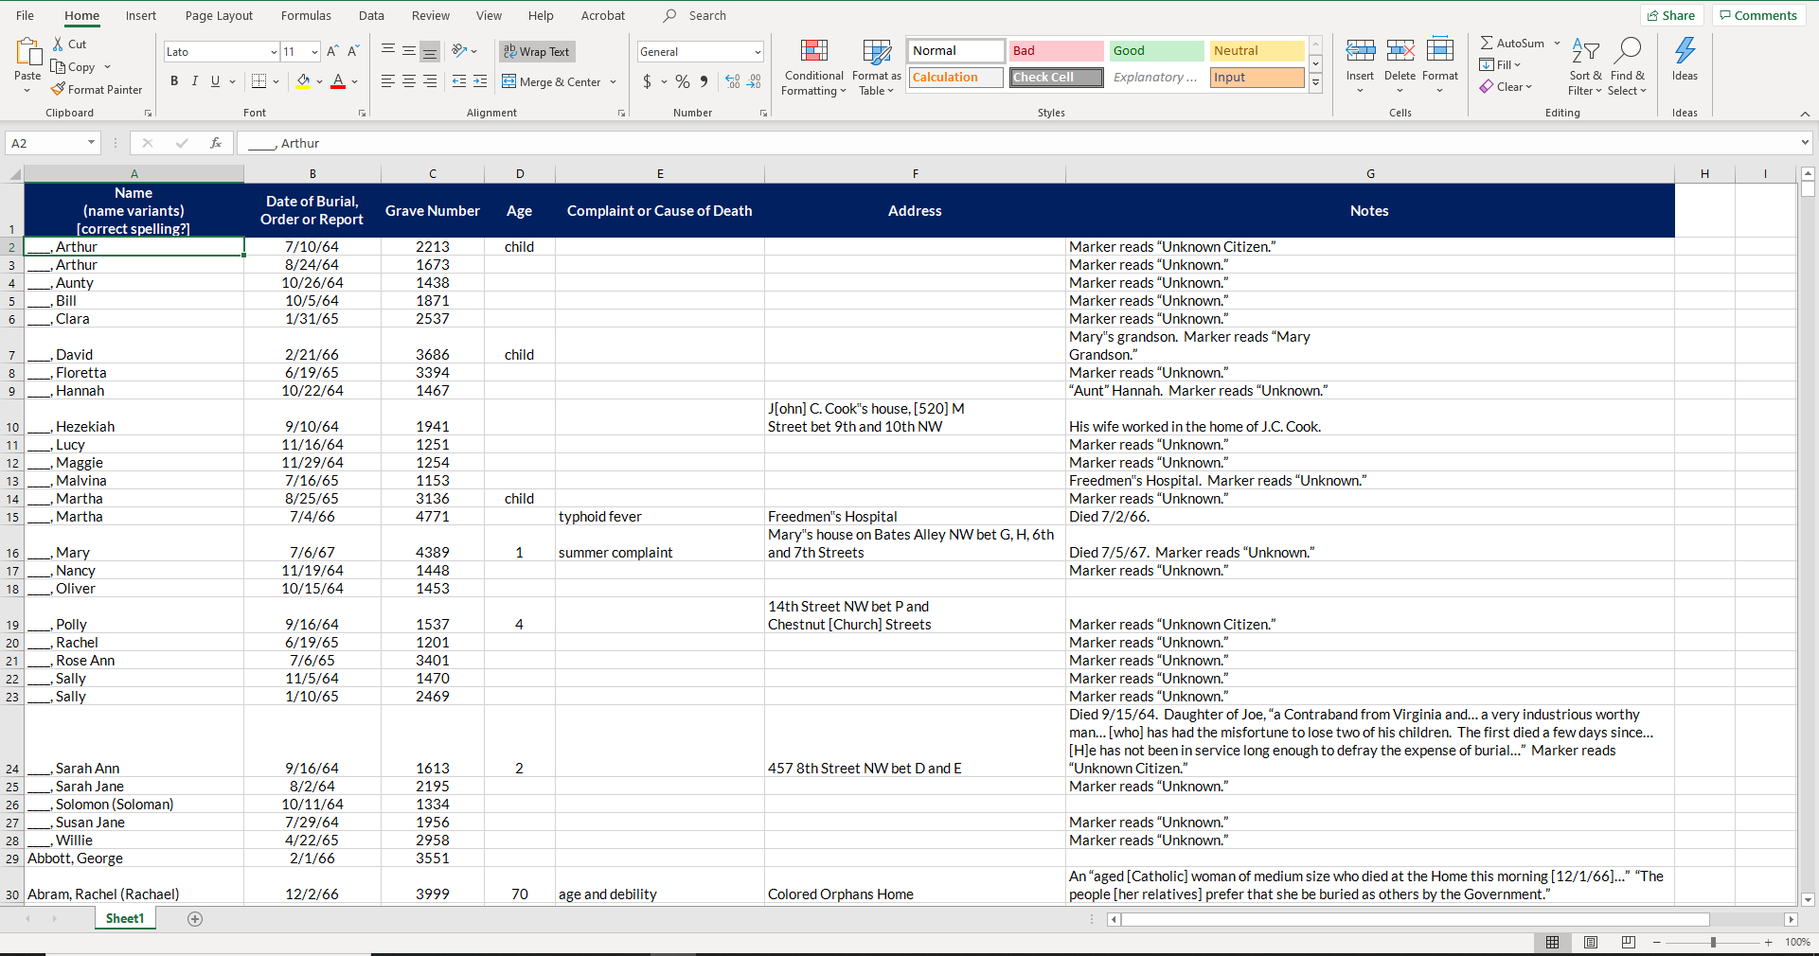
Notes:
We are mainly going to use two spreadsheet skills while looking at the data in this record. First is the “Find” feature. Find allows you to search the spreadsheet for a specific word or phrase. You can open Find by holding down Ctrl+F or clicking “Find & Select” on the far-right of the Toolbar.
Suggested Find exercises:
Use Find to look up whether anyone on the burial record has the same last name as you. Responses will vary
Use Find to look up Elizabeth Couch’s age. 101
Use Find to look up Casey Muddy’s cause of death. “taken sick 4th July from drinking ice water”

Slide 10
Notes:
The next skill is Sorting, which allows you to arrange data in ways that are easier to analyze. You can Sort by clicking on Data in the Ribbon, then Sort. Select which column you would like to sort by, then the order you would like it sorted by (for instance, sort the cell values alphabetically, A to Z).
Suggested Sort exercises:
Sort the spreadsheet by Grave Number. What is the smallest grave number? 1098
Sort the spreadsheet by Name, alphabetically. How many Unknown burials are there? 385 (376 singular Unknowns, plus five Unknown men, two Unknown children, and two Unknown infants)

Slide 11
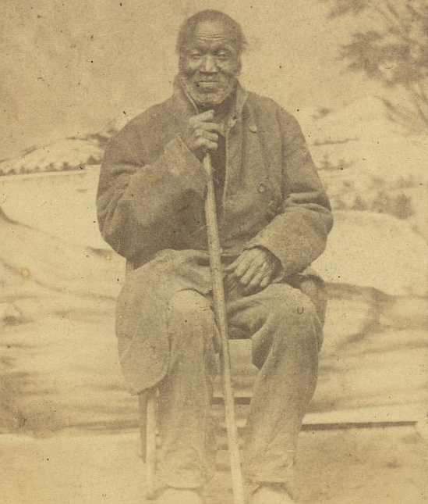
DATA INSIGHTS
What were some of the most common causes of death?
What inferences can you make about people’s lives based on these common diseases and causes of death?
ARLINGTON NATIONAL CEMETERY
HISTORY EDUCATION SERIES
Portrait of an unidentified African American man. (Library of Congress/between 1860-1870)
Notes:
Now let’s use the spreadsheet to explore a bit more about what life was like for freedpeople at this time. Sort the spreadsheet by Complaint or Cause of Death.
Ask: What are some of the most common causes of death?
Allow students time to read through list – Consumption and Diarrhea are the most common, but many others have a number of entries.
Cholera, dysentery, diarrhea, and typhoid fever are all spread by contaminated food and water and can be prevented by proper sanitation.
Consumption, phthisis, and scrofula are all now known as tuberculosis, and along with pneumonia and whooping cough are spread through the air.
Ask: What inferences can you make about what people’s lives were like at this time, based on the most common causes of death?
Responses will vary, but may include: sanitation was poor, people lived in close quarters, there was very little prenatal care, antibiotics and vaccines did not exist yet.
Photo: Full-length portrait of an elderly African American man seated with a cane, facing front. Photograph. Between 1860-1870. Library of Congress. https://www.loc.gov/item/2010647828/

Slide 12
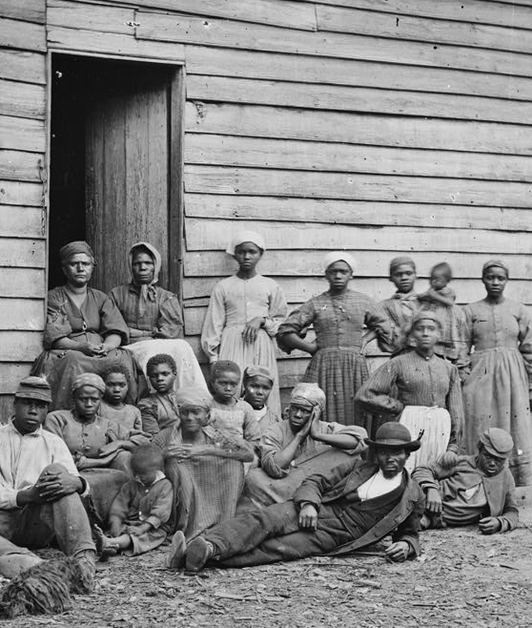
DATA INSIGHTS
What were some of the most common addresses/locations?
What could a historian learn from the location of someone’s death?
ARLINGTON NATIONAL CEMETERY
HISTORY EDUCATION SERIES
A group of contrabands in Cumberland Landing, Virginia. (Library of Congress/James F. Gibson, 1862)
Notes:
Now sort the spreadsheet by Address.
Ask: What are some common locations? Allow students time to read through list - the four most common locations are Claremont Cemetery, East Capitol Street Barracks, Freedmen’s Hospital, and Giesboro Cemetery.
Those from Claremont Cemetery and Giesboro Cemetery are reinterments, moved to Arlington National Cemetery to deal with overcrowding.
The East Capitol Street Barracks was one of the tenements operated by the Freedmen’s Bureau to provide more affordable housing for freedpeople.
The Freedmen’s Hospital was operated by the Freedmen’s Bureau, and in 1868 it became a teaching hospital for the Howard University medical school.
Ask: What could a historian learn from the location of someone’s death?
Responses will vary, but may include: an individual’s race, wealth/social status, social connections
Photo: Gibson, James F. Cumberland Landing, Va. Group of "contrabands" at Foller's house. Photograph. Cumberland Landing, Virginia, 1862. Library of Congress.
https://www.loc.gov/item/2018666163/

Slide 13
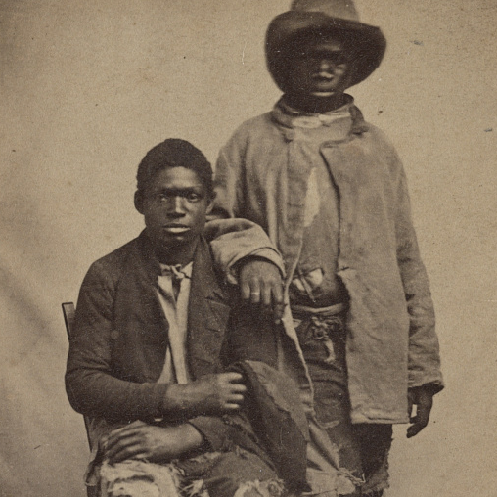
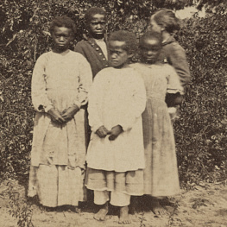
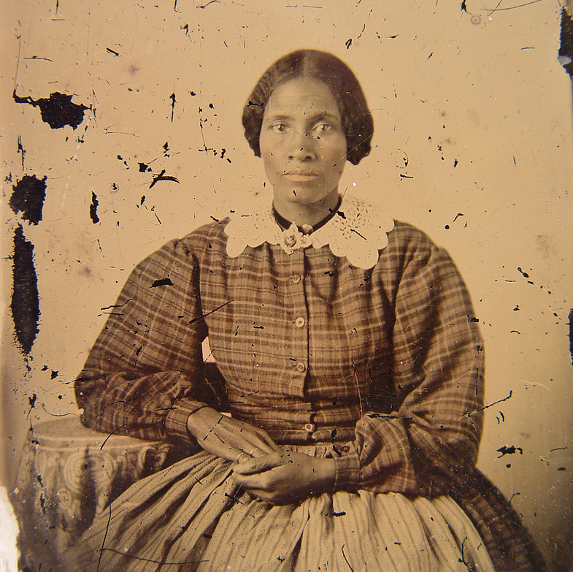
THINK LIKE A HISTORIAN
What are the strengths and limitations of a source like this?
What additional information would you like to know about these people?
What resources could give you this information?
Two unidentified escaped slaves.
(LOC/Mcpherson & Oliver, between 1861-1865)
Group of unidentified schoolchildren.
(LOC/Erastus Hubbard, 1862)
Unidentified African American woman.
(LOC/between 1860-1870)
ARLINGTON NATIONAL CEMETERY HISTORY EDUCATION SERIES
Notes:
Historians and biographers have to use many different resources to piece together information about people of the past. For most of the African American civilians buried in Section 27 of Arlington National Cemetery, this burial record is the only information available about them.
Ask: Based on your exploration of these burial records, what are some strengths of a source like this?
Responses will vary, but may include: contains information about a lot of different people, data is raw and uninterpreted
Ask: What are some limitations of a source like this?
Responses will vary, but may include: information may be missing or wrong, data represents a limited sample, record has limited information about daily lives of individuals
What additional information would you like to know about these people? What sources would be able to give you this information? Responses will vary, but encourage students to think creatively.
Examples:
Appearance: photographs, diary entries, medical records
Residence: census records, tax records, diary entries
Family members: census records, church records, diary entries
Opinions and attitudes: diary entries, newspaper articles
Job: census records, labor records, diary entries
Photo: Mcpherson & Oliver. Two unidentified escaped slaves wearing ragged clothes / Photographed by McPherson & Oliver, Baton Rouge, La. Photograph. Baton Rouge, Louisiana. Between 1861-1865. Library of Congress. https://www.loc.gov/item/2017659658/
Photo: Hubbard, Erastus. Group school children / photographed by E. Hubbard, Beaufort, S.C. Photograph. Beaufort, South Carolina, 1862. Library of Congress. https://www.loc.gov/item/2015646736/
Photo: Unidentified African American woman. Photograph. Between 1860-1870. Library of Congress. https://www.loc.gov/item/2010648882/

Slide 14
WRITE AN OBITUARY
EXAMPLE
Name
Date of burial
Grave number
Age
Address
Cause of death
Paragraph describing two historic events from their lifetime and how those events may have affected them
Henry Jones, 60, was buried December 20, 1866. He died of dropsy at William Ford’s house, on 3rd Street NW between L and New York Avenue. The Panic of 1837 happened when he was about 31, and if Mr. Jones worked on a plantation in the South he may have been sold multiple times as many plantation owners went bankrupt during this time. In 1845, Texas was admitted to the United States as a slave state, which greatly expanded the amount of territory a slave like Mr. Jones may have lived in. Mr. Jones is buried at Arlington National Cemetery in Section 27, grave number 3997.
ARLINGTON NATIONAL CEMETERY
HISTORY EDUCATION SERIES
Notes:
While we know little about those buried in Section 27, their lives should not be forgotten. To honor their memory, select an individual on the burial record spreadsheet and write a short obituary that includes the following information:
Name
Date of Burial
Grave number
Age
Address
Cause of Death
Most obituaries include some information about the person’s life, but since we do not have that information, write a paragraph that describes two historic events that happened during the person’s lifetime, and how these events may have affected this person’s life.

