Slide 1
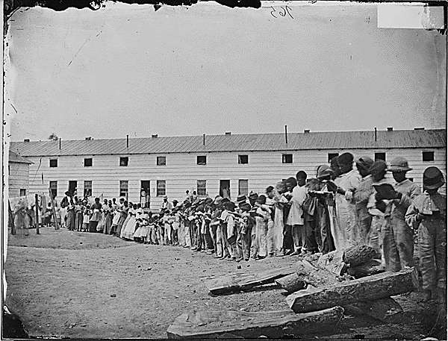
FREEDMAN’S VILLAGE
Adults and children read books in front of their barracks at the Freedman’s Village. (NARA, ca. 1861-1865)
FREEDMAN’S VILLAGE
QUESTIONS OF OWNERSHIP & RIGHTS
ARLINGTON NATIONAL CEMETERY HISTORY EDUCATION SERIES

Slide 2
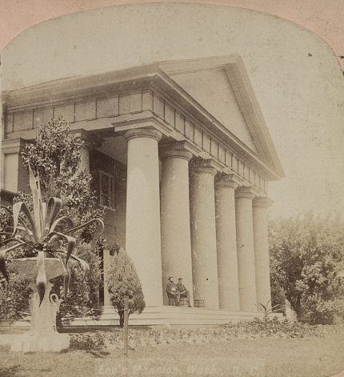
VIRGINIA, 1887
22 years since the 13th Amendment (1865) ended slavery in all U.S. states and territories
You’ve heard rumors that the government is going to close down Freedman’s Village at Arlington
Naturally you have a lot of questions
Arlington House was the home of the Custis and Lee families. (LOC, ca. 1860-1900)
ARLINGTON NATIONAL CEMETERY HISTORY EDUCATION SERIES

Slide 3
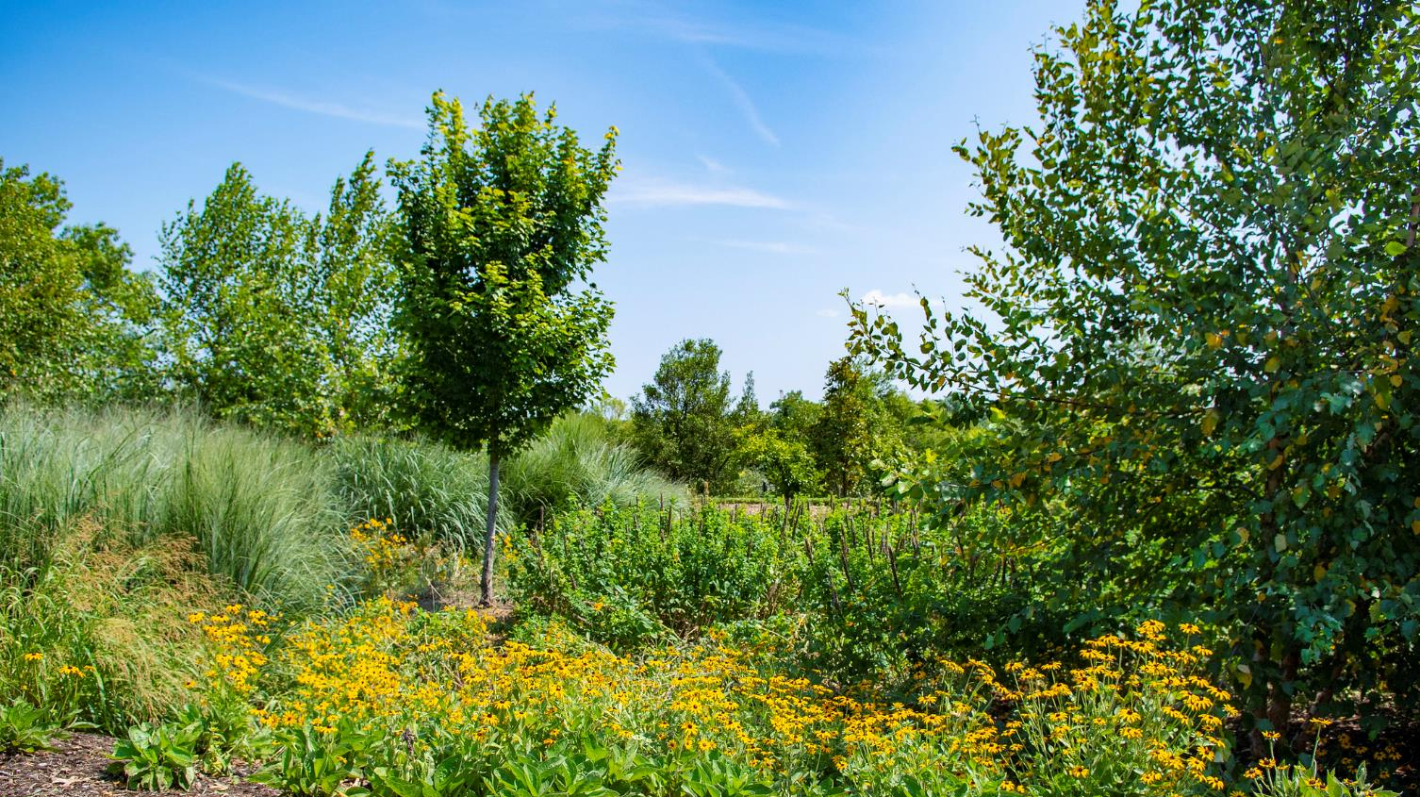
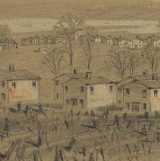
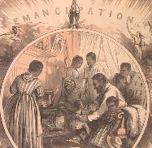
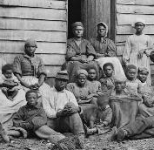
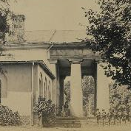
QUESTIONS
QUESTIONS
What is Freedman’s Village?
How long has it been around?
Who lives there?
Who wants to shut it down? Why?
ARLINGTON NATIONAL CEMETERY
HISTORY EDUCATION SERIES
Rain gardens at Arlington National Cemetery. (ANC/Elizabeth Fraser, 2019)
Notes:
Captions, clockwise from top left:
1864 drawing of buildings in Freedman’s Village. (LOC/Alfred R. Waud)
1865 engraving shows an African American family responding to emancipation. (LOC/Thomas Nast)
Arlington House in 1864. (LOC/Andrew J. Russell)
A group of “contrabands” outside a house in 1862. (LOC/James F. Gibson)

Slide 4
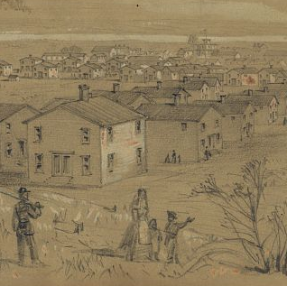
YOUR MISSION TODAY
Gather Information:
Who lives in the Village?
How long have they lived there?
Who wants to close the Village?
Why do they think it should be closed?
Why do some people think it should stay open?
Form an opinion:
As a concerned local citizen, what do you think should happen?
1864 drawing of Freedman’s Village. (LOC/Afred R. Waud)
ARLINGTON NATIONAL CEMETERY HISTORY EDUCATION SERIES

Slide 5
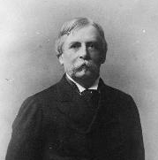
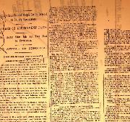
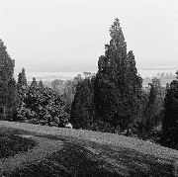
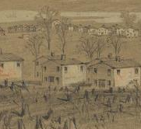
EXPERT GROUPS
What are the writers’ opinions and arguments?
2: Government Experts:
Read correspondence between Cemetery, Army, and Gov’t
1: Resident Experts:
Read Villagers to Gov’t
3: Public Opinion:
Read Newspaper Article #1
4: Village History:
Read Newspaper Article #2
5: Village Facts:
Read Village Fast Facts and examine images
ARLINGTON NATIONAL CEMETERY HISTORY EDUCATION SERIES
Notes:
Captions, clockwise from top left:
Adults and children read books in front of their barracks at the Freedman’s Village. (NARA, ca. 1861-1865)
William C. Endicott in 1886 (LOC)
Washington, D.C. and the Potomac River from Arlington National Cemetery. (LOC, ca. 1895-1910)
1864 drawing of buildings in Freedman’s Village. (LOC/Alfred R. Waud)
A page of May 17, 1890 the Washington Evening Star. (Newspapers.com)
A photograph of the December 8, 1887 New York Herald. (ANC Archives)

Slide 6
REASONS TO CLOSE
REASONS TO CONTINUE
(back of worksheet)
ARLINGTON NATIONAL CEMETERY
HISTORY EDUCATION SERIES

Slide 7
DISCUSSION
Are the only options keeping the village open or closing it?
What arguments do you find compelling?
Which reasons aren’t convincing?
ARLINGTON NATIONAL CEMETERY
HISTORY EDUCATION SERIES

Slide 8
REFLECTION QUESTIONS
Now that we’ve discussed different viewpoints about closing the village, what’s your opinion?
1
(back of worksheet)
If the residents are removed, are they entitled to any compensation?
2
Are there any other solutions or compromises that should be considered?
3
ARLINGTON NATIONAL CEMETERY
HISTORY EDUCATION SERIES

Slide 9
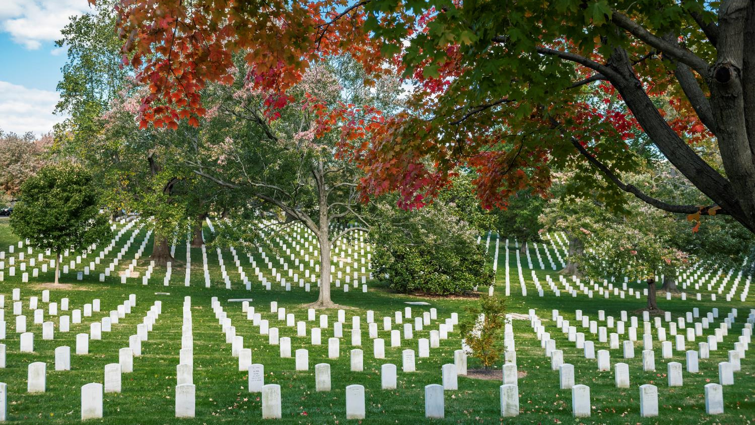
EXTENDED DISCUSSION
In an 1865 speech titled “What the Black Man Wants,” Frederick Douglass said:
“…in regard to the colored people there is always more that is benevolent, I perceive, than just, manifested towards us. What I ask for the negro is not benevolence, not pity, not sympathy, but simply justice. The American people have always been anxious to know what they shall do with us… Everybody has asked the question… “What shall we do with the negro?” I have had but one answer from the beginning. Do nothing with us! Your doing with us has already played the mischief with us. Do nothing with us! … And if the negro cannot stand on his own legs, let him fall also. All I ask is, give him a chance to stand on his own legs! Let him alone! … If you will only untie his hands, and give him a chance, I think he will live.”
Section 35 of Arlington National Cemetery in the fall. (ANC/Elizabeth Fraser, 2018)
Notes:
The Extended Discussion questions require additional time (see Lesson Extensions). Before using any of them, please consider carefully which concepts fit your instructional goals and best meet the needs of your learners.
Questions:
In what ways did Freedman’s Village provide freed people with justice? In what ways did it fall short of justice?
What changes do you think Douglass would have suggested to Freedman’s Village? What things about the village do you think he would have approved of?

Slide 10
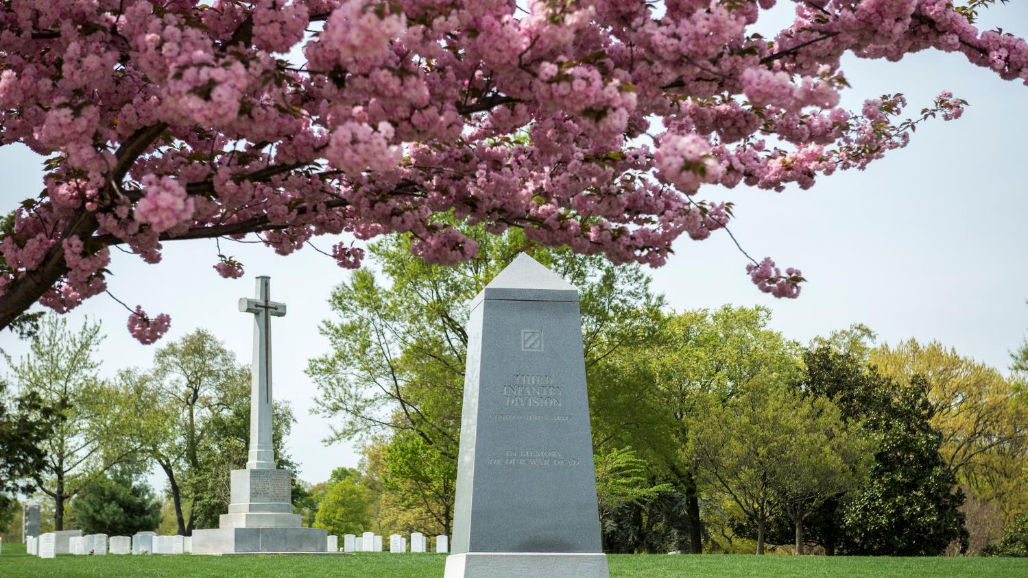
EXTENDED DISCUSSION
In 1865, Major General William Tecumseh Sherman, Secretary of War Edwin M. Stanton, and a group of African American ministers, with Garrison Frazier as spokesperson, met in Savannah, Georgia to discuss the condition and needs of the newly freed Black population. Frazier’s recommendations included:
“The way we can best take care of ourselves is to have land, and turn it and till it by our own labor…and we can soon maintain ourselves and have something to spare… We want to be placed on land until we are able to buy it and make it our own.”
“I would prefer to live by ourselves, for there is a prejudice against us in the South that will take years to get over; but I do not know that I can answer for my brethren.”
Section 46 of Arlington National Cemetery during spring time. (ANC/Elizabeth Fraser, 2019)
Notes:
The Extended Discussion questions require additional time (see Lesson Extensions). Before using any of them, please consider carefully which concepts fit your instructional goals and best meet the needs of your learners.
Discussion Questions:
How was Freedman’s Village an opportunity to try Frazier’s recommendations?
How did Freedman’s Village fall short of what Frazier recommended?
The transcribed text of the meeting can be found here: http://www.freedmen.umd.edu/savmtg.htm
The original newspaper article can be found here: https://chroniclingamerica.loc.gov/lccn/sn83030213/1865-02-13/ed-1/seq-5/

