Slide 1
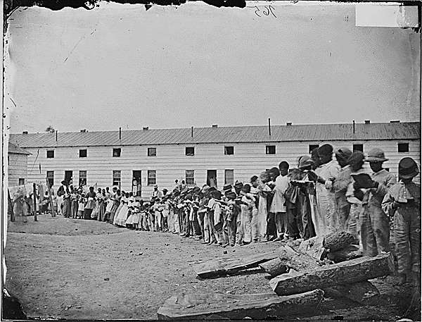
FREEDMAN’S VILLAGE
Adults and children read books in front of their barracks at the Freedman’s Village. (NARA, ca. 1861-1865)
FREEDMAN’S VILLAGE
HELPING FREED PEOPLE GET A START
ARLINGTON NATIONAL CEMETERY HISTORY EDUCATION SERIES

Slide 2
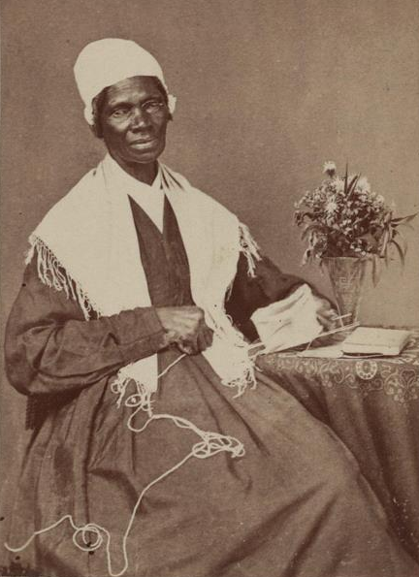
SOJOURNER TRUTH & THE KIDNAPPING PLOT
1797: Born into slavery in New York
1826: Escaped from slavery
1843: Changed her name and became an abolitionist and supporter of women’s rights
1864: Lived in Freedman’s Village
Sojourner Truth in 1864. (LOC)
ARLINGTON NATIONAL CEMETERY HISTORY EDUCATION SERIES

Slide 3
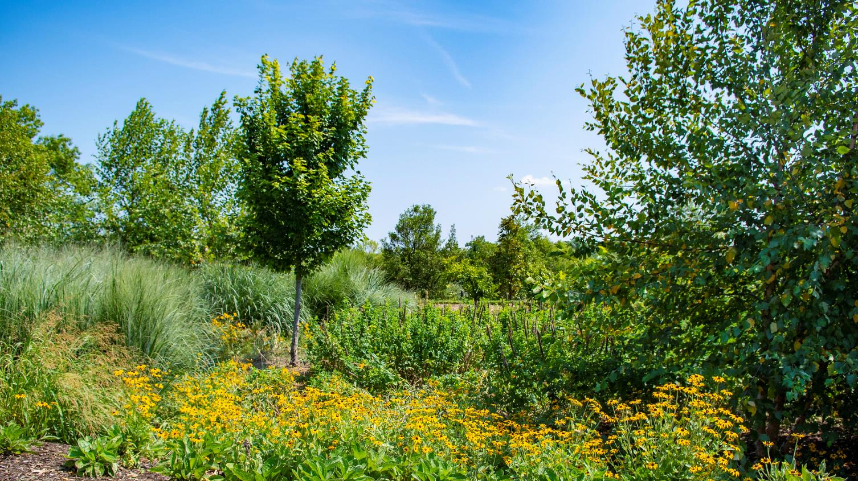
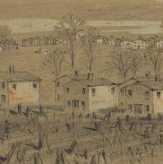
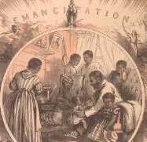
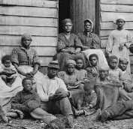
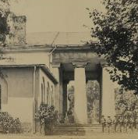
QUESTIONS
QUESTIONS
What is Freedman’s Village?
How long has it been around?
Who lives there?
Why is Truth living there?
ARLINGTON NATIONAL CEMETERY
HISTORY EDUCATION SERIES
Rain gardens at Arlington National Cemetery. (ANC/Elizabeth Fraser, 2019)
Notes:
Captions, clockwise from top left:
1864 drawing of buildings in Freedman’s Village. (LOC/Alfred R. Waud)
1865 engraving shows an African American family responding to emancipation. (LOC/Thomas Nast)
Arlington House in 1864. (LOC/Andrew J. Russell)
A group of “contrabands” outside a house in 1862. (LOC/James F. Gibson)

Slide 4
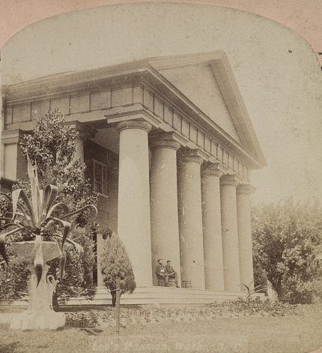
VIRGINIA, 1887
What do we know about the Civil War?
What do we know about Reconstruction?
What do we know about the lives of freed people?
Arlington House was the home of the Custis and Lee families. (LOC, ca. 1860-1900)
ARLINGTON NATIONAL CEMETERY HISTORY EDUCATION SERIES

Slide 5
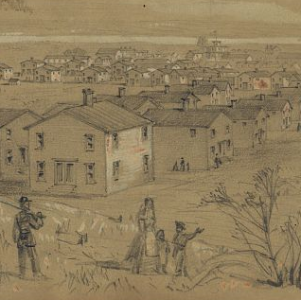
YOUR MISSION ON DAY 1
Gather Information:
Who lives in the Village?
How long have they lived there?
Why was the village built?
Why would people want to live there?
What problems existed?
Become Informed: As a concerned local citizen, do you understand Freedman’s Village?
1864 drawing of Freedman’s Village. (LOC/Afred R. Waud)
ARLINGTON NATIONAL CEMETERY HISTORY EDUCATION SERIES

Slide 6
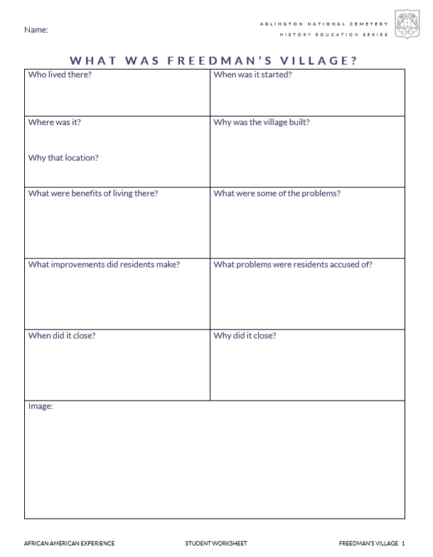
DISCUSSION
What information did you find in the fact sheet?
Did you have to make any inferences?
Was there any information you couldn’t find?
ARLINGTON NATIONAL CEMETERY
HISTORY EDUCATION SERIES

Slide 7
YOUR MISSION ON DAY 2
Consult more resources:
Who wants to close the Village?
Why do they think it should be closed?
Why do some people think it should stay open?
Form an opinion: As a local citizen, what do you think should happen?
1864 drawing of Freedman’s Village. (LOC/Afred R. Waud)
ARLINGTON NATIONAL CEMETERY HISTORY EDUCATION SERIES

Slide 8
YOUR MISSION ON DAY 2
Consult more resources:
Who wants to close the Village?
Why do they think it should be closed?
Why do some people think it should stay open?
Become informed: What can the residents of the Village tell you about it?
1864 drawing of Freedman’s Village. (LOC/Afred R. Waud)
ARLINGTON NATIONAL CEMETERY HISTORY EDUCATION SERIES

Slide 9
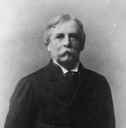
EXPERT GROUPS
What are the writers’ opinions and arguments?
1: Resident Experts:
Read Villagers to Gov’t
2: Government Experts:
Read correspondence between Cemetery, Army, and Gov’t
Top: Adults and children read books in front of their barracks at the Freedman’s Village (NARA, ca. 1861-1865)
Bottom: William C. Endicott in 1886 (LOC)
ARLINGTON NATIONAL CEMETERY
HISTORY EDUCATION SERIES

Slide 10
REASONS TO CLOSE
REASONS TO CONTINUE
(back of worksheet)
ARLINGTON NATIONAL CEMETERY
HISTORY EDUCATION SERIES

Slide 11
DISCUSSION
Are the only options keeping the village open or closing it?
What reasons do you think are strong?
Which reasons aren’t convincing?
ARLINGTON NATIONAL CEMETERY
HISTORY EDUCATION SERIES

Slide 12
REFLECTION QUESTIONS
Now that we’ve discussed different viewpoints about closing the village, what’s your opinion?
1
(back of worksheet)
If the residents are removed, are they entitled to any compensation?
2
Are there any other solutions or compromises that should be considered?
3
ARLINGTON NATIONAL CEMETERY
HISTORY EDUCATION SERIES

