Slide 1
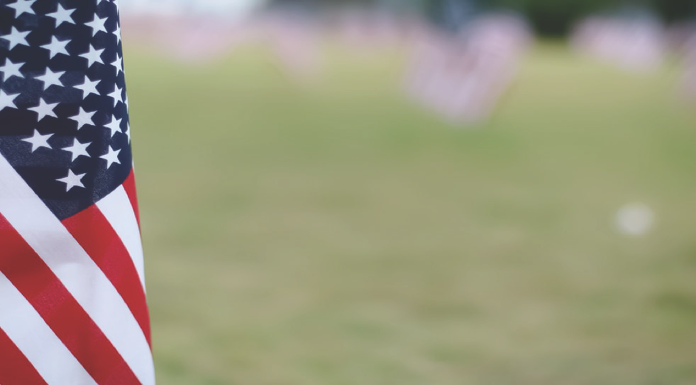
The Buffalo Soldiers
The 9th and 10th Cavalry Regiments
The 24th and 25th Infantry Regiments
ARLINGTON NATIONAL CEMETERY HISTORY EDUCATION SERIES
Notes:
Ask students to make a guess: Who were the Buffalo Soldiers?
If students are stuck, encourage them to think about where the Buffalo Soldiers might have fought given the word “buffalo.”

Slide 2
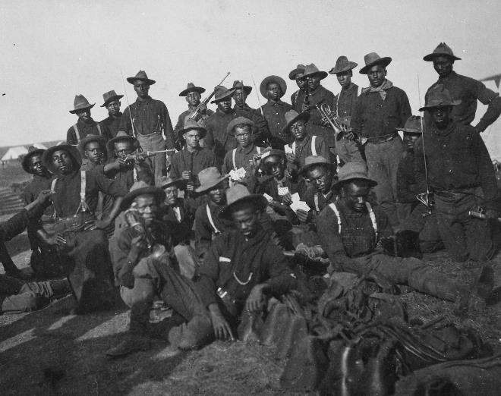
BEGINNINGS
Six all-African American Army regiments established by Congress in 1866 (soon merged into four regiments)
Originally commanded by white officers
Stationed on western frontier to promote westward expansion
Suffered from racism and discrimination
1898 photo of a group of Buffalo Soldiers at Camp Wikoff, New York. (NARA)
ARLINGTON NATIONAL CEMETERY HISTORY EDUCATION SERIES
Notes:
In 1866, the U.S. Congress established six (later merged into four) all-African American Army regiments. In almost all cases, these all-Black regiments were commanded by white officers. Not all white officers were willing to command African American regiments; some white officers, like George Armstrong Custer, chose to turn down promotions rather than command a Black regiment.
The four regiments were originally stationed on the western frontier to protect and promote westward expansion and to fight in the “Indian Wars.” They built roads and other infrastructure to support new settlements and they guarded settlers and U.S. mail routes.
Buffalo Soldiers were originally only permitted to serve west of the Mississippi River because of the racial tensions in the East; after the Civil War, many white communities did not want armed African Americans near their communities. Even west of the Mississippi River, Buffalo Soldiers sometimes suffered deadly violence at the hands of white civilians.
Photo: Photograph of a Group of African-American Soldiers at Camp Wikoff, New York. Photograph. 1898. National Archives. https://catalog.archives.gov/id/530699

Slide 3
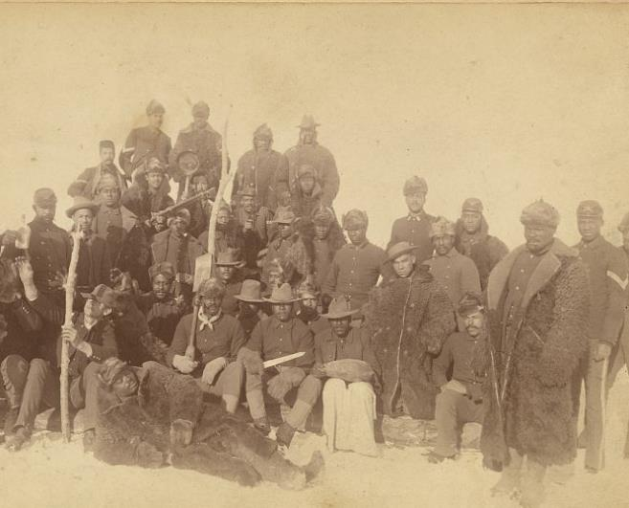
THE NAME
Nickname likely given to African American soldiers by Native Americans they encountered in the West
Two theories for origin of nickname:
African American soldiers’ dark, curly hair resembled a buffalo’s mane
Soldiers fought as fiercely as Great Plains buffalo
1890 photo of soldiers of the 25th Infantry, some wearing buffalo robes, in Fort Keogh, Montana. (LOC/Chr. Barthelmess)
ARLINGTON NATIONAL CEMETERY HISTORY EDUCATION SERIES
Notes:
While serving in the west, the soldiers gained their popular nickname: Buffalo Soldiers. While no one knows for sure where the nickname “Buffalo Soldiers” originated, it was likely the name Native American warriors gave to the Black soldiers they fought or encountered in the West. Popular lore contends Native Americans called the soldiers “Buffalo Soldiers” either because their dark curly hair resembled a buffalo’s mane or because the soldiers fought as fiercely as Great Plains buffalo.
Photo: Bathelmess, Chr. [Buffalo soldiers of the 25th Infantry, some wearing buffalo robes, Ft. Keogh, Montana] / Chr. Barthelmess, photographer, Fort Keogh, Montana. Photograph. December 14, 1890. Library of Congress. https://www.loc.gov/item/98501226/

Slide 4
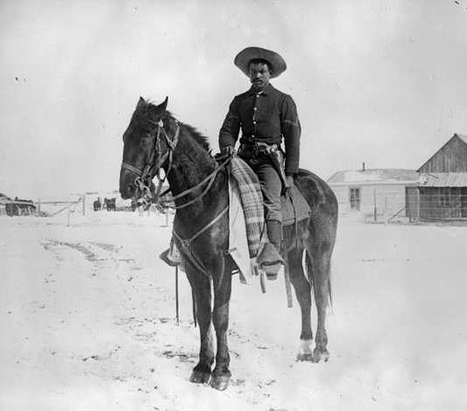
INDIAN WARS
Fought between 1870 and 1890 to protect westward expansion
Soldiers fought Native American nations, including Lakota, Comanches, Sioux
Buffalo Soldiers’ success helped overcome resistance to African Americans serving in the military, but led to destruction of Native American communities
1891 photo of a soldier of the 9th Cavalry on the Pine Ridge Reservation in South Dakota. (Denver Public Library/C.G. Morledge)
ARLINGTON NATIONAL CEMETERY HISTORY EDUCATION SERIES
Notes:
The “Indian Wars” were a series of military conflicts during and after the Civil War between the United States and various Native Americans nations, including the Lakota, Comanches, Sioux, and Cheyenne. The “Indian Wars” started with the Dakota War of 1862 and ended with the Wounded Knee Massacre in 1890. The United States waged the “Indian Wars” to promote and protect American westward expansion to the detriment of Native communities throughout the west. As a result of the “Indian Wars,” Native Americans were massacred and often forced off of their lands and onto reservations or to assimilate into American culture and society.
The Buffalo Soldiers’ success in fighting the Indian Wars helped overcome resistance to Black officers and paved the way for the first African American — Henry O. Flipper — to graduate from West Point Military Academy. However, their success came at the expense of the destruction of many Native American lives and communities.
Consider this paradox: The Buffalo Soldier’s service in the Indian Wars was used by African American soldiers to gain respect and more rights within American society, but it also led to the destruction of Native American communities. Consider the repercussions of westward expansion and the “Indian Wars” for the United States, African American servicemen, and Native Americans.
Note: Buffalo Soldiers were not the only soldiers to fight in the “Indian Wars” and they should not be held wholly responsible for the United States’ decimation of Native American communities.
Photo: Morledge, C.G. Pine Ridge Agency, S. D. trooper, Buffalo Soldier Corporal. Photograph. 18981. Denver, Colorado: Denver Public Library. https://digital.denverlibrary.org/digital/collection/p15330coll22/id/23968

Slide 5
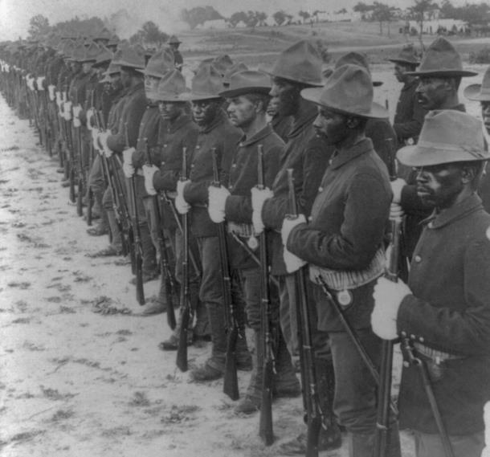
SPANISH-AMERICAN WAR
Deployed to Cuba in 1898 during the Spanish-American War
Served with distinction at battles of Las Guasimas, El Caney, and San Juan Hill
Soldiers of 24th Infantry forced to work as nurses and orderlies during yellow fever outbreak
1899 photo of Buffalo Soldiers in formation. (LOC)
ARLINGTON NATIONAL CEMETERY HISTORY EDUCATION SERIES
Notes:
After the United States declared war on Spain in April 1898, Buffalo Soldiers were stationed on the east coast of the United States for the first time in their history. The soldiers were originally stationed in Florida to help prepare them for the Cuban climate. While in Florida, they faced overt racism from the local white citizenry and were subject to local discriminatory laws.
Buffalo Soldiers served with distinction in the battles of Las Guasimas, El Caney, and San Juan Hill in Cuba during the Spanish-American War. They were distinctly praised for their bravery in the Battle of San Juan Hill where they fought alongside Theodore Roosevelt’s Rough Riders.
The terrain and climate in Cuba proved challenging to all U.S. soldiers and disease was the biggest killer of the war. During a yellow fever outbreak, African American soldiers in the 24th Infantry were forced to serve as nurses and hospital orderlies for sick white soldiers, due to the false notion that African Americans were both more physically equipped to deal with the tropical climate and that they were immune to tropical diseases like yellow fever. This belief was based on racist assumptions and prejudice and had no medical basis.
Photo: Some of our brave colored boys who helped to free Cuba. Photograph. 1899. Library of Congress. https://www.loc.gov/item/2007682340/

Slide 6
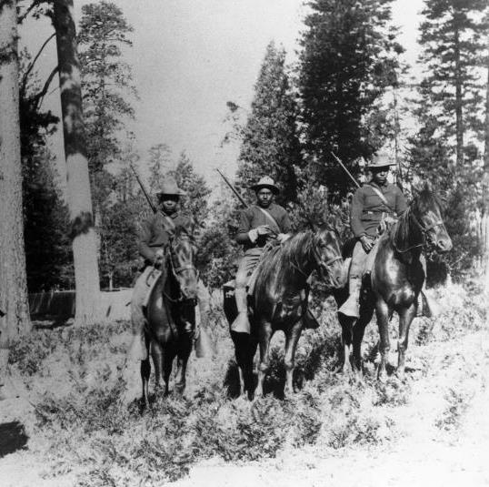
NATIONAL PARKS
Between 1891 and 1913, the U.S. Army maintained and protected national parks
Over 500 Buffalo Soldiers served as some of the nation’s first park rangers
Constructed roads and trails, protected park wildlife and raw materials from poaching and thievery, and fought wildfires
Charles Young served as the first African American superintendent of a national park
Young and his men constructed more roads and trails than the men the three previous years combined
1899 photo of soldiers in the 24th Infantry patrolling Yosemite. (NPS)
ARLINGTON NATIONAL CEMETERY HISTORY EDUCATION SERIES
Notes:
Between 1891 and 1913, the U.S. Army maintained and protected Yosemite and Sequoia National Parks. Soldiers stationed in national parks constructed roads and trails, protected park wildlife and raw materials from poaching and thievery, and fought wildfires. During this time, nearly 500 Buffalo Soldiers served in Yosemite and Sequoia.
In 1903, Charles Young served as the acting military superintendent of Sequoia National Park, becoming the first African American superintendent of a national park. Although he only held this position for a single summer, his command had lasting impact. He and his troops built as many roads as soldiers built during the past three years combined, and completed the first road into Giant Forest and the first trail to the top of Mt. Whitney (the tallest peak in the contiguous U.S.)
Photograph: In this 1899 photo, Buffalo Soldiers in the 24th Infantry carried out mounted patrol duties in Yosemite. Photograph. 1899. National Park Service. https://www.nps.gov/yose/learn/historyculture/buffalo-soldiers.htm

Slide 7
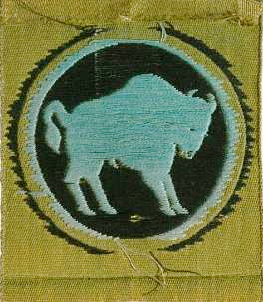
WORLD WAR I AND II
Original Buffalo Soldier regiments not assigned to European combat during World War I
Some African American soldiers did serve in combat during World War I as part of other units
92nd Infantry Division adopted buffalo as their symbol; served in Europe during World War I and World War II
9th and 10th Cavalry inactivated during World War II
24th and 25th Infantry assigned to labor and support assignments in Pacific during World War II
92nd Infantry Division shoulder patch (Smithsonian)
ARLINGTON NATIONAL CEMETERY HISTORY EDUCATION SERIES
Notes:
When the United States entered World War I, Buffalo Soldier regiments expected they would join the American Expeditionary Forces (AEF) to fight in France; however, the U.S. Army and federal government excluded Buffalo Soldiers from the AEF and instead assigned Buffalo Soldiers to nonimportant locations like the Mexico border and Hawaii. No Buffalo Soldier served in any major capacity during World War I and one of the few African American officers at the time — Charles Young — was even forced into medical retirement to prevent him from serving in the war and commanding white troops.
While none of the original Buffalo Soldier regiments served in combat during World War I, there were African American soldiers in other units that did. The 92nd Infantry Division, a racially segregated division that served in Europe during World War I and World War II, adopted the buffalo as their symbol and took on the nickname “Buffalo Soldiers.”
During World War II, the 9th and 10th Cavalry Regiments were inactivated and soldiers of those units were reassigned to support roles. The 24th and 25th Infantry Regiments were assigned to the Pacific theater, where they were mostly given labor and support assignments.
Photo: Insignia shoulder patch for the 92nd Infantry Division. Photograph of object. National Museum of African American History & Culture, Smithsonian Institution. https://nmaahc.si.edu/object/2011.155.219

Slide 8
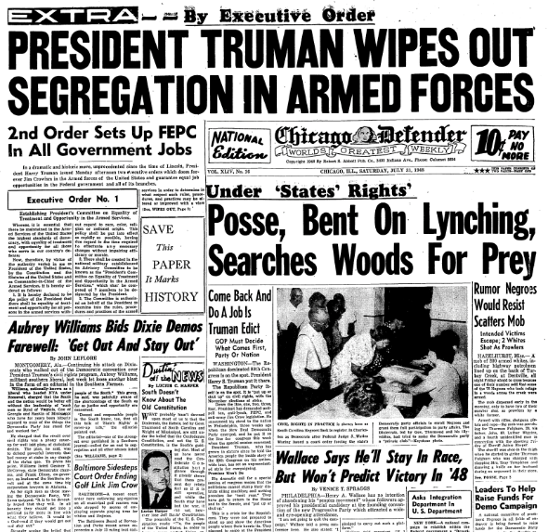
DISBANDMENT & DESEGREGATION
In 1948, President Harry Truman desegregated the military
Black soldiers were integrated into white units; white soldiers were never integrated into Black units
In 1951, the last of the original Buffalo Solider units was disbanded
July 31, 1948 issue of the Chicago Defender announces President Truman’s order to desegregate the military. (LOC)
ARLINGTON NATIONAL CEMETERY HISTORY EDUCATION SERIES
Notes:
On July 26, 1948, President Harry Truman signed Executive Order 9981 ending segregation in the military. The order stated “that there shall be equality of treatment and opportunity for all persons in the armed services without regard to race, color, religion, or national origin.” African American soldiers were gradually integrated into white units; however, white soldiers were never integrated into Black units. In 1951, the last of the original Buffalo Soldier units was disbanded.
Ask: Military desegregation, like almost all forms of desegregation in the United States, integrated the minority population into the majority population. Do you think this is the best way to integrate? Why or why not?
Photo: By Executive Order--President Truman Wipes Out Segregation in Armed Forces. Photograph of object. Chicago, Illinois: Chicago Defender. Library of Congress. https://www.loc.gov/exhibits/odyssey/educate/truman.html

Slide 9
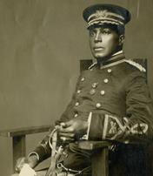
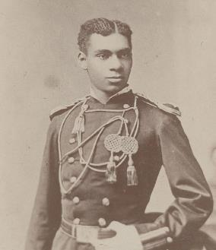
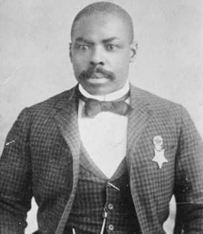
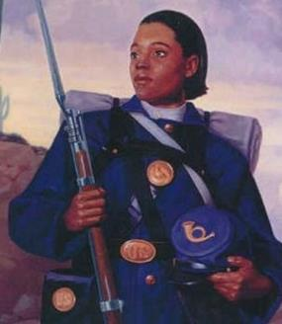
NOTABLE MEMBERS
Colonel Charles Young
Became first African American superintendent of a national park in 1903; became first African American colonel in 1917
Lieutenant Henry O. Flipper
Became first African American graduate of West Point and first African American commissioned officer in U.S. Army in 1877
Charles Young in military dress uniform sometime between 1915-1920. (LOC)
1877 photo of Henry O. Flipper in uniform. (NARA)
Private Cathay Williams
Became first African American woman to enlist in the U.S. Army in 1866; discharged when doctor discovered she was a woman
Corporal Isaiah Mays
Received Medal of Honor in 1890 for actions during raid of Army pay wagon
Painting of Cathay Williams at Marine Corps Logistics Base Barstow. (U.S. Marine Corps)
1900 photo of Isaiah Mays wearing his Medal of Honor. (LOC)
ARLINGTON NATIONAL CEMETERY HISTORY EDUCATION SERIES
Notes:
Colonel Charles Young:
Charles Young was born into slavery in 1864 in Mays Lick, Kentucky. In 1884, Young entered the United States Military Academy at West Point. Despite facing years of racism and struggling academically, he became the third African American to graduate from West Point in 1889.
During the summer of 1903, Young served as the first African superintendent of a national park. Between 1889 and 1917, Young served in various posts around the world; he was promoted to major in 1912, lieutenant colonel in 1916, and colonel in 1917 – the first African American to receive this rank.
Although Young successfully reached the rank of colonel, it was not without racial pushback. In July 1917, the Army forced Young to retire for “medical reasons.” This was likely done to prevent Young from commanding white troops in World War I. To protest this decision and prove his fitness, Young rode over 500 miles on horseback from Ohio to Washington, D.C. He was eventually reinstated near the end of the war and was assigned to train African American soldiers in Illinois.
Young died in 1921 while serving as a military envoy in Africa. His funeral, held in the Memorial Amphitheater of Arlington National Cemetery, was attended by thousands of mourners.
Photo: [Charles Young, full-length portrait, seated, facing left, in military dress uniform]. Photograph. Between 1915-1920. Library of Congress. https://www.loc.gov/item/95518886/
Lt. Henry O. Flipper:
Henry Ossian Flipper was born into slavery in Thomasville, Georgia, March 21, 1856. After the Civil War, Flipper attended Atlanta University, and in 1873, U.S. Representative James C. Freeman appointed him to West Point Military Academy. While attending West Point, Flipper and the four other African American cadets who were enrolled faced enormous hostility and discrimination from the white cadets. In 1877, Flipper overcame harassment, isolation, and insults to become the first African American graduate of West Point and the first African American commissioned officer in the regular U.S. Army.
Lieutenant Flipper served as the commander of the 10th Cavalry on the western frontier; however, in 1881, Flipper’s commanding officer accused him of embezzling money. A court martial found Flipper not guilty of embezzlement but convicted him of unbecoming conduct and dishonorably discharged him from the Army. This punishment was harsher than many white officers had received for similar convictions in the past, and Flipper petitioned Congress to be reinstated to the Army, stating that if they reviewed his case they would “readily be convinced that the crime of being a Negro was, in my case, far more heinous than deceiving the commanding officer.”
Flipper spent the rest of his life attempting to clear his name, however, he never succeeded. In 1976, 36 years after his death, the Army granted Flipper an honorable discharge, and in 1999, President Bill Clinton issued Flipper a full pardon.
Photo: Photograph of Lt. Henry O. Flipper. Photograph. 1877. https://catalog.archives.gov/id/2668824
Corporal Isaiah Mays
Isaiah Mays was born into slavery in 1858 in Virginia. He joined the Army in 1881, and by May 1889 he was a corporal in the 24th Infantry Regiment. On May 11, 1889, he and some other men from his regiment were escorting a U.S. Army pay wagon when they were ambushed by bandits. Mays fought bravely, and despite being shot in both legs, he managed to walk and crawl two miles to a ranch for help. For his actions that day, he was awarded the Medal of Honor on February 15, 1890. Sadly, after Mays left the Army he was denied his federal pension, and he died in poverty. For many years, his grave was only marked by a numbered stone in a hospital cemetery in Arizona. However, in 2009, his remains were moved to Arlington National Cemetery and are now marked with a stone that reflects his status as a Medal of Honor recipient.
Photo: [Corporal Isaiah Mays, half-length portrait, seated, facing front]. Photograph. 1900. Library of Congress. https://www.loc.gov/item/97506070/
Private Cathay Williams
Cathay Williams was born into slavery in Missouri in 1844. In 1861, she escaped to the Union Army and worked as a cook and washerwoman. On November 15, 1866, she enlisted as “William Cathay” in the 38th U.S. Infantry Regiment (later reorganized as the 24th Infantry Regiment), passing herself off as a man. She was the first African American woman to enlist in the Army, and the only known female Buffalo Soldier. She served with the regiment in New Mexico until July 1868, when she became ill and a doctor discovered she was a woman. She was honorably discharged from the Army in October 1868, and despite her service, was denied a disability pension. The exact date of her death is unknown, but she likely died in 1893 in Trinidad, Colorado.
Photo: Pearson, Laurie. Black History Month 2018 [Image 3 of 3]. Photograph. February 8, 2018. Marine Corps Logistics Base Barstow, California. DVIDS. https://www.dvidshub.net/image/4136648/black-history-month-2018

Slide 10
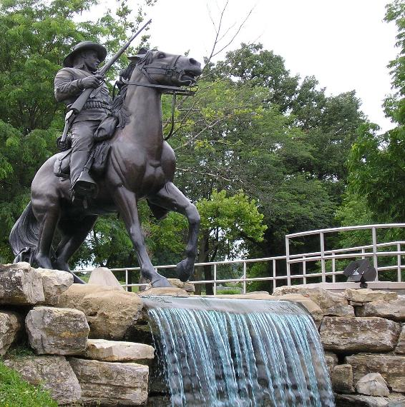
LEGACY
Buffalo Soldiers’ service inspired other African Americans and helped them gain rights and respect in military
However, their service in the Indian Wars contributed to destruction of Native American communities
Monument to the Buffalo Soldiers in Fort Leavenworth, KS. (U.S. Army)
ARLINGTON NATIONAL CEMETERY HISTORY EDUCATION SERIES
Notes:
The Buffalo Soldiers’ service in the face of racism and discrimination inspired other African Americans and helped them gain rights and respect within the U.S. military. There are a number of monuments, parks, and exhibits across the United States that celebrate their service and remind the public of their bravery. However, the many years that Buffalo Soldiers spent fighting in the Indian Wars does complicate their legacy raises questions about how to appropriately honor the military service of those who carried out orders that destroyed many Native American communities.
Photo: ALeavenworth003. Photograph. Center of Military History, U.S. Army. https://history.army.mil/LC/Explore/A_Journey_Forth/ALeavenworth003.JPG

Slide 11
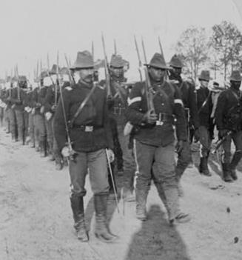
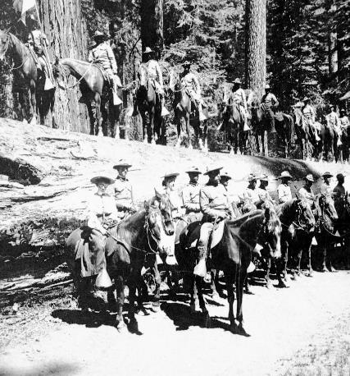
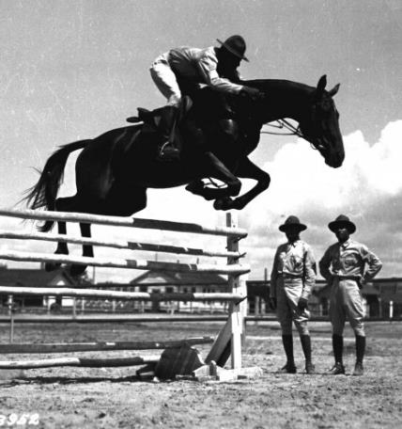
CONNECTIONS
Does the story of the Buffalo Soldiers remind you of anything else you have learned?
What connections can you make to your prior knowledge?
1898 photo of soldiers of the 24th Infantry marching. (LOC)
1904 photo of soldiers of the 9th Cavalry in Yosemite National Park. (NPS)
1941 photo of a soldier riding while at infantry school in Fort Benning, Georgia . (U.S. Army)
ARLINGTON NATIONAL CEMETERY HISTORY EDUCATION SERIES
Notes:
Now that you’ve been introduced to the Buffalo Soldiers, what connections can you make to other things you have learned in class?
Photo: Tramp, tramp, tramp for Cuba - 24th U.S. Infantry. Photograph. 1898. Meadville, Pennsylvania: Keystone View Company. Library of Congress. https://www.loc.gov/item/97517890/
Photo: Copy Neg: Leroy Radanovich, February 2002. Stereoview. #705 "Troop D, 9th Cav., on the trunk of the Fallen Monarch, Mariposa Grove, Cal., USA" Copied courtesy of Dean Shenk. See also RL-19,829 and RL-13,563. [Buffalo Soldiers]. Photograph. 1904. National Park Service. https://npgallery.nps.gov/YOSE/AssetDetail/179c4415f0ba4fc5bf1d1cd716209cee
Photo: SC123952 - Sergeant John Hill riding on Jumping Dan Ware, the finest jumping horse in the Infantry Stables. Photograph. July 25, 1941. Fort Benning, Georgia. Center of Military History, U.S. Army. https://history.army.mil/topics/afam/buffalo.htm

