Slide 1

6888TH Central Postal Directory Battalion
^{THE “SIX TRIPLE EIGHT”}
ARLINGTON NATIONAL CEMETERY HISTORY EDUCATION SERIES
Notes:
People in the military do a wide variety of jobs. Some are combat-related, while others are not.
Ask: What are some responsibilities of the military or jobs that people in the military may have that are not combat related?
Answers may include: Medical, Room & Board, Training & Education, Building Infrastructure (forts, roads, cemeteries), Postal
Ask: Why might the military need an entire unit dedicated to mail?
Answers may include:
• Friends and family send letters and packages to servicemembers
• Letters were especially integral when they were the only form of communication available between servicemembers and their loved ones
• Letters from home were a morale booster during wartimes because it reminded servicemembers what and who they were fighting for
Class Brainstorm: When do you think the most mail was sent to servicemembers and why? What time period might we be discussing today?
Answers may include:
• During a war
• Before the internet and phones existed/were common/inexpensive

Slide 2
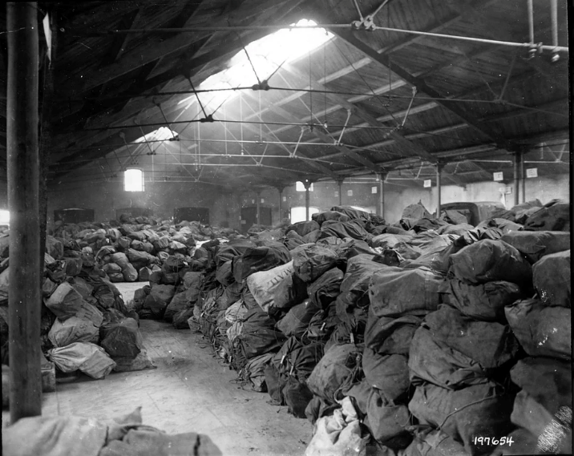
THE PROBLEM
February 1945 – warehouses in Birmingham, England were filled with millions of pieces of undelivered mail, some of which had been there 2+ years
Servicemembers noticed they weren’t getting mail, which hurt morale
1944 photo of the large amount of Christmas mail en route to U.S. troops. (Buffalo Educational and Historical Committee)
ARLINGTON NATIONAL CEMETERY HISTORY EDUCATION SERIES
Notes:
For U.S. military personnel deployed in Northwest Europe during World War II, few things mattered more than receiving word from home: from care packages to letters from their mother, correspondence from family meant the world to servicemen and -women. This vital service faced a crisis in February of 1945, however. U.S. military postal warehouses in Birmingham, England had reached a bursting point. Literally millions of pieces of postal material sat undelivered, with no relief in sight. Compounding the problem, much of the mail lay mismarked, bearing addresses such as “Junior or Buster, US Army.”
Ask: Why was the mail backed up?
Answers may include:
• Ever-changing locations of servicemembers and units
• Common names (7,500 servicemembers were named Robert Smith)
• Mail addressed too simply (i.e. “Junior, U.S. Army” or “Buster, U.S. Army”)
• Constant stream of incoming mail
Photo: One of two similar buildings in France, which house the vast quantities of Christmas Mail en route to American soldiers. Photograph. December 1944. Buffalo Soldier Educational and Historical Committee. https://www.womenofthe6888th.org/photo-gallery?lightbox=dataItem-jfe4crix

Slide 3
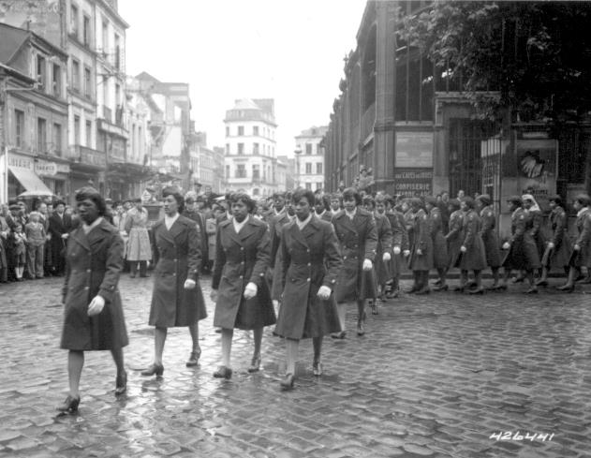
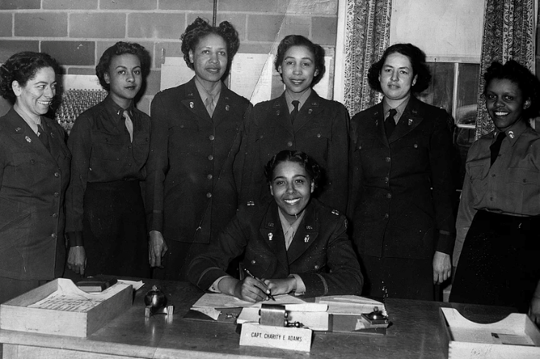
THE SIX TRIPLE EIGHTS
What can you tell about the 6888th Central Postal Directory Battalion from these photographs?
1945 photo of the 6888th Battalion in the parade honoring Joan d’Arc. (NARA)
Women of the 688th Battalion with Maj. Charity Adams. (Buffalo Soldier Educational and Historical Committee)
ARLINGTON NATIONAL CEMETERY HISTORY EDUCATION SERIES
Notes:
Ask: What can you tell about the 6888th from these photographs?
Answers may include:
• All women
• All African American
• Segregated working/living conditions (students might infer this based on previous knowledge)
The 6888th Central Postal Directory Battalion, popularly known as the “six triple eight,” was an African American unit of the Women’s Army Corps (WAC). They were charged with sorting the massive backlog of undelivered mail in both England and France during World War II. The WACs were initially restricted to only white women, but in November 1944, African American women were permitted to join. The 6888th was the only non-medical African American women’s unit to serve overseas during WWII. The first contingent of women sailed for England February 3, 1945.
Photo: "Members of the 6888th Central Postal Directory Battalion take part in a parade ceremony in honor of Joan d'Arc at the marketplace where she was burned at the stake.“ Photograph. May 27, 1945. National Archives. https://catalog.archives.gov/id/531431
Photo: Maj Adams. Photograph. Buffalo Soldier Educational and Historical Committee. https://www.womenofthe6888th.org/photo-gallery?lightbox=dataItem-jfe4crj26

Slide 4
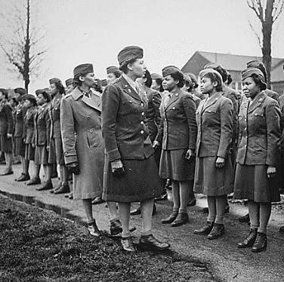
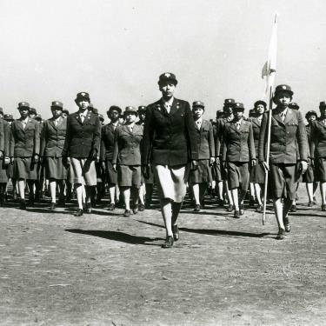
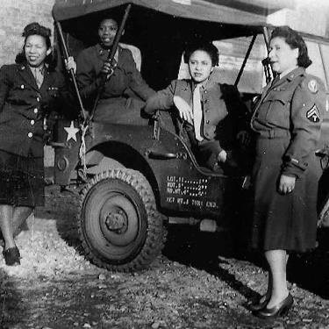
WHO WERE THE SIX TRIPLE EIGHTS?
Maj. Adams drilling her company. (Buffalo Soldier Educational and Historical Committee)
Four members of the 6888th Battalion. (Buffalo Soldiers Educational And Historical Committee)
1945 photo of an inspection of the first African American WAC. (NARA)
Battalion: a military unit typically consisting of 300 to 800 soldiers (6888th had 824 enlisted personnel and 31 officers)
WACs: The Women’s Army Corps (WAC) was created in 1943. Other than nurses, the WAC were the first women to serve in the U.S. Army.
African American women: The 6888th was the only all-African American, all-female unit that served overseas during WWII.
ARLINGTON NATIONAL CEMETERY HISTORY EDUCATION SERIES
Notes:
Who were the Six Triple Eights:
• Battalion describes a military unit typically consisting of 300-800 soldiers
• The 6888th was a unit of The Women’s Army Corps (WAC), which was created in 1943. WACs were the first non-medical female units to serve in the Army.
• The 6888th was an African American unit. They were the only African American woman’s unit to serve overseas during World War II.
When Congress signed the bill creating the WAC into law on July 3, 1943, the Women’s Army Auxiliary Corps (WAAC) was converted into the Women’s Army Corps. The key difference between the WAAC and the WAC is that WAC were officially part of the Army, and therefore eligible for Army benefits like protection if captured and veteran’s medical coverage, while WAAC were not—they were auxiliaries serving alongside the Army.
Photo: "Somewhere in England, Maj. Charity E. Adams,...and Capt. Abbie N. Campbell,...inspect the first contingent of Negro members of the Women's Army Corps assigned to overseas service.“ Photograph. February 15, 1945. National Archives. https://catalog.archives.gov/id/531249
Photo: Women’s Army Auxiliary Corps (WAAC) Captain Charity Adams of Columbia, NC Drilling Her Company at the First WAAC Train. Photograph. Buffalo Soldier Educational and Historical Committee. https://www.womenofthe6888th.org/photo-gallery?lightbox=dataItem-jfe4criz3
Photo: Four Unit Members with Jeep from Defense. Photograph. Buffalo Soldiers Educational and Historical Committee. https://www.womenofthe6888th.org/photo-gallery?lightbox=dataItem-jfe4criy5

Slide 5
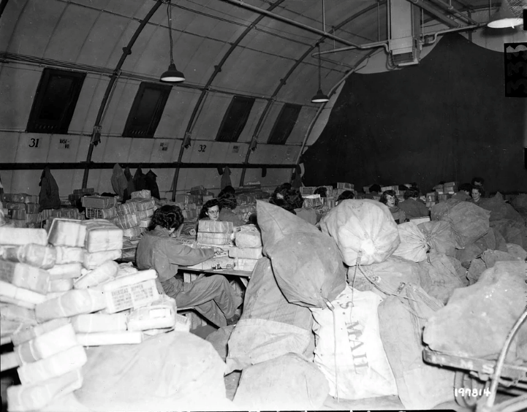
THE WORK: Birmingham, England
Responsible for delivering mail to nearly 7 million American troops stationed across Europe
Worked in dimly-lit warehouses without heat—windows were painted over for blackout conditions
Worked eight-hour rotating shifts, seven days a week
Completed the task in half the time predicted
1944 photo of WACs sorting Christmas parcels for troops in Europe. (Buffalo Soldiers Educational and Historical Committee)
ARLINGTON NATIONAL CEMETERY HISTORY EDUCATION SERIES
Notes:
The WACS had to work through warehouses stuffed to overflowing. In many cases, the 6888th worked in dimly lit and often cold buildings. Rats proved a constant problem, as the rodents sought out packages containing food stuffs.
The 6888th used around seven million information cards with names and serial numbers to distinguish individuals with the same name. “Undeliverable” mail was sent to the 6888th to determine the intended recipient. The unit was also responsible for returning mail addressed to servicemembers who had died while serving in the war.
The unit’s motto: “No mail, low morale”
Photo: Speeding overseas Christmas parcels to American troops in the ETO, WACS at this large U.S. Army base post office in England trace correct units and postal addresses through locator cards, representing every American serviceman and woman in the theater. Photograph. December 9, 1944. Buffalo Soldiers Educational and Historical Committee. https://www.womenofthe6888th.org/photo-gallery?lightbox=dataItem-jfe4crix1

Slide 6
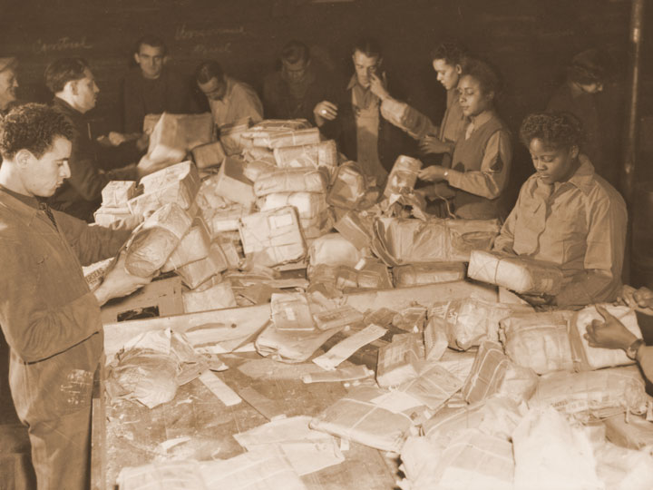
THE WORK: France
In May 1945, the 6888th transferred to Rouen, France to sort the two-three-year mail back-up in France
Once again, completed a six-month job in three months
In October 1945, they transferred to Paris where they continued their work sorting and distributing mail until they finished in March 1946
Members of the 6888th Battalion sorting mail with French civilians. (U.S. Army Women’s Museum)
ARLINGTON NATIONAL CEMETERY HISTORY EDUCATION SERIES
Notes:
In May 1945, with the war in Europe officially over, the 6888th transferred to Rouen, France, to sort the two to three-year mail back-up in France. Once again, they completed a six-month job in three months. In October 1945, they transferred to Paris where they continued their work sorting and distributing mail until they finished in March 1946. While in France, French civilians (male and female) and German POWs assisted the 6888th sorting the mail.
The 6888th encountered mail theft while in France. France was devastated by the war and its populace suffered tremendously from shortages, death, and destruction. At times, the 6888th women were forced to search the French civilians they worked with to recover small packages or items from packages.
Photo: Members of the 6888th work with French civilians to sort the mail. Photograph. U.S. Army Women’s Museum, VA. U.S. Army Center of Military History. https://history.army.mil/html/topics/afam/6888thPBn/index.html

Slide 7
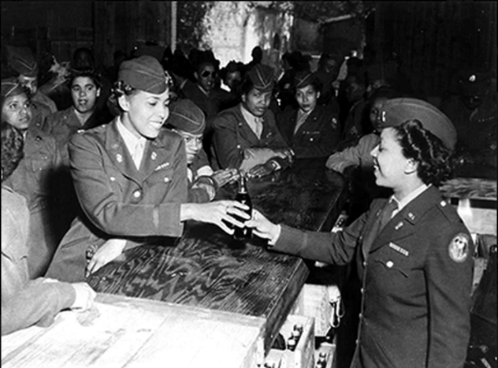
EXPERIENCING RACISM
Slept in segregated barracks and ate in segregated dining halls; all recreational activities were also segregated
Often had a better relationship with Birmingham locals than with white American military units or American organizations
Received a better reception in France—recreational activities were less segregated and the women were cheered for during a parade in Rouen
Major Charity Adams at the opening of the WAC snack bar. (Buffalo Soldiers Educational and Historical Committee)
ARLINGTON NATIONAL CEMETERY HISTORY EDUCATION SERIES
Notes:
The 6888th experienced a great deal of racism while serving in Europe. While in England, all of their activities – social and professional – were segregated. The 6888th was further segregated because facilities were not only segregated by race, but also by gender.
The 6888th often had a better relationship with locals in Birmingham, England, than with white American military units or American organizations. The American Red Cross ran clubs and hotels for American servicemembers during World War II. Both male African American and white servicemembers and personnel were permitted in these clubs and hotels, but African American WACs were not. The American Red Cross offered alternative, segregated facilities for the 6888th women, but Major Charity Adams led a boycott of those facilities to protest segregation. The 6888th ran their own mess hall, hair salon, refreshment bar, and other recreational facilities while stationed in England. The 6888th was entirely self-sufficient because they had to be, as no white personnel would perform service jobs for African American women.
Despite U.S. Army segregation policies, duty in France proved enjoyable for the WACs. They were welcomed by the newly liberated French and cheered for during a victory parade in Rouen. They participated and won a number of sporting events, riding under special orders in a custom first-class train car after having been earlier denied access to segregated U.S. Army transportation trains. In Paris, they even had maid service and chef-cooked meals, a luxury they never had elsewhere because no white personnel would perform service jobs for African American women.
Photo: Major Charity Adams at Opening of WAC snack bar. Photograph. Buffalo Soldiers Educational and Historical Committee. https://www.womenofthe6888th.org/photo-gallery?lightbox=dataItem-jfe4criz2

Slide 8
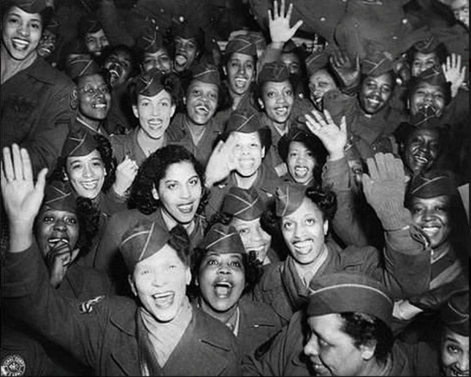
LEGACY
After the 6888th completed the work in Paris, the unit was disbanded
Received no acclaim when returned to United States
Most members of the 6888th retired from the military after unit disbanded
Forced the U.S. Army to recognize that African American women were capable of serving in the military
Recognized by U.S. Army Freedom Team Salute in 2009; monument at Fort Leavenworth, KS dedicated in 2018
Women of the 6888th Central Postal Directory Battalion cheering. (Buffalo Soldiers Educational and Historical Committee)
ARLINGTON NATIONAL CEMETERY HISTORY EDUCATION SERIES
Notes:
After the 6888th completed their work in Paris, the unit was disbanded. When they returned home to the United States, they received little acclaim or recognition for their service. Following the disbandment of the unit, most members of the 6888th left the military.
The Six Triple Eights’ service forced the U.S. Army to recognize that African American women were capable of serving in the military. A government report on the Women’s Army Corps issued in December 1945 concluded that “the national security program is the joint responsibility of all Americans irrespective of color or sex…the continued use of colored, along with white, female military personnel is required in such strength as is proportionately appropriate to the relative population distribution between colored and white races.”
In recent years, the service of the 6888th has received more recognition. On February 25, 2009, the U.S. Army Freedom Team Salute held a commendation ceremony for the unit at the Women in Military Service for America Memorial at Arlington National Cemetery. In November 2018, a monument featuring the names of the battalion members and a bust of its leader Lieutenant Colonel Charity Adams Earley was unveiled at Fort Leavenworth, Kansas. Living members of the 6888th were able to attend both of those events.
Photo: Women’s army corps military women. Photograph. Buffalo Soldiers Education and Historical Committee. https://www.womenofthe6888th.org/photo-gallery?lightbox=dataItem-jfe4crj04

Slide 9
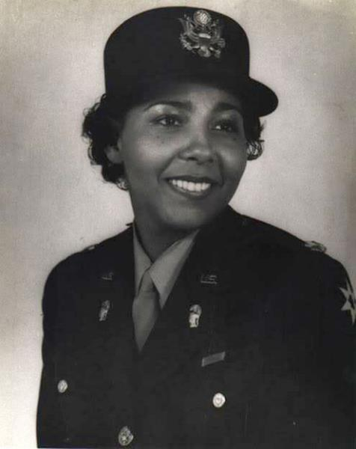
NOTABLE MEMBER
Lieutenant Colonel Charity Adams
One of the first African American women to receive an Army commission
At the end of the war, she was a lieutenant colonel and the highest ranking African American woman in the Army
Born December 5, 1918; graduated from Wilberforce University in 1938 with a degree in math and physics
Joined the WAAC (later WAC) in 1942, becoming its first African American officer
Chosen to lead the 6888th
Fought against racism and segregation during her time in the military
Photo of Lieutenant Colonel Charity Adams (Buffalo Soldiers Educational and Historical Committee)
ARLINGTON NATIONAL CEMETERY HISTORY EDUCATION SERIES
Notes:
Charity Adams was the commanding officer of the 6888th Central Postal Directory Battalion.
Born December 5, 1918, to parents who always emphasized the importance of education, Adams graduated as her high school’s valedictorian and graduated from Wilberforce University in Ohio in 1938 with a degree in math and physics. When the U.S. Army’s Women’s Army Auxiliary Corps created in 1942, Adams applied and she quickly became one of the first African American officers in the WAAC, and later the WAC.
In December 1944, Adams was chosen as the commanding officer of the six triple eights. In this position, Adams not only led the 6888th as they sorted and delivered mail to over seven million soldiers in half the time the unit was given to complete the task, but she also fought for racial and gender equality. She consistently protested against any form segregation and she worked to create camaraderie between white and Black enlisted personnel and officers. On December 26, 1945, Adams was promoted to lieutenant colonel for her work in the WAC and commanding the 6888th.
Photo: Charity Earley. LTC Charity Adams Earley. Photograph. Buffalo Soldiers Educational and Historical Committee. https://www.womenofthe6888th.org/photo-gallery?lightbox=dataItem-jfe4criy7

Slide 10
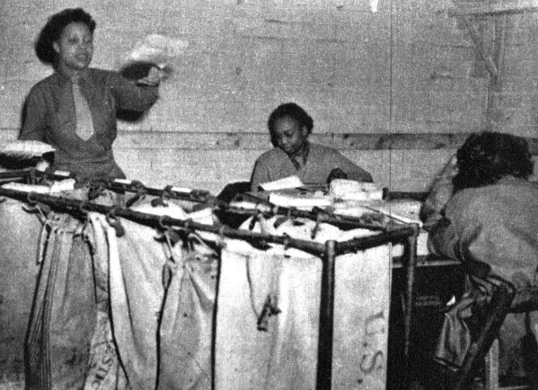
CONNECTIONS
Does the story of the 6888th Central Postal Directory Battalion remind you of anything else you have learned?
What connections can you make to your prior knowledge?
Women of the 6888th Central Postal Directory Battalion sorting mail.(NARA)
The 6888th Central Postal Directory Battalion marching in a parade in England. (Buffalo Soldiers Educational and Historical Committee)
ARLINGTON NATIONAL CEMETERY HISTORY EDUCATION SERIES
Notes:
Now that you’ve been introduced to the 6888th Central Postal Directory Battalion, what connections can you make to other things you have learned in class?
Photo: Members of the 6888th sorting mail. Photograph. National Archives. U.S. Army Center of Military History. https://history.army.mil/html/topics/afam/6888thPBn/index.html
Photo: 6888th Battalion Parade in England. Photograph. Buffalo Soldiers Educational and Historical Committee. https://www.womenofthe6888th.org/photo-gallery?lightbox=dataItem-jfe4criy6

