Slide 1

369th INFANTRY REGIMENT
THE HARLEM RATTLERS
ARLINGTON NATIONAL CEMETERY HISTORY EDUCATION SERIES
Notes:
Ask students to make a guess: What was the 369th Infantry Regiment? Who were the Harlem Rattlers?

Slide 2
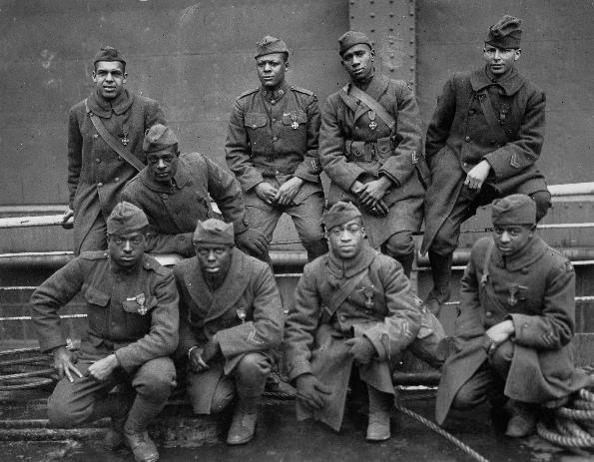
BACKGROUND
One of the most distinguished records of any unit in the United States Army
Fought in World War I and World War II
Most men in regiment were African American, though some Puerto Ricans joined unit during World War I
1919 photo of soldiers of the 369th Infantry Regiment on their way home from war. (NARA)
ARLINGTON NATIONAL CEMETERY HISTORY EDUCATION SERIES
Notes:
The 369th Infantry Regiment, nicknamed the Harlem Rattlers, had one of the most distinguished records of any unit in the history of the United States Army. It saw extensive combat in both World War I and World War II. Most of the men in the regiment were African American, although when the unit mobilized for war in 1917 approximately a dozen Puerto Ricans were drafted or enlisted into the regiment.
Photo: Colored Troops – New York’s Colored Regiment Returns Home on Stockholm. Photograph. International Film Service, February 12, 1919. National Archives. https://catalog.archives.gov/id/26431282

Slide 3
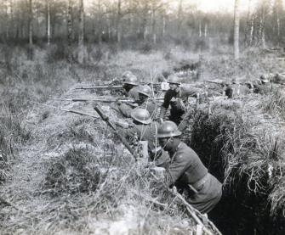
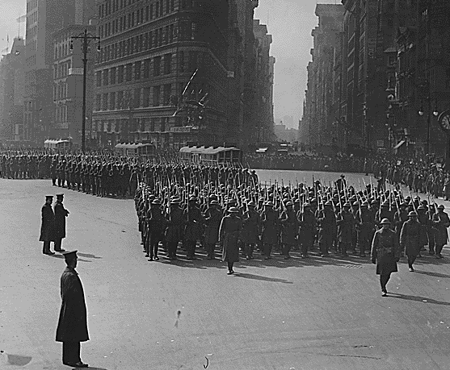
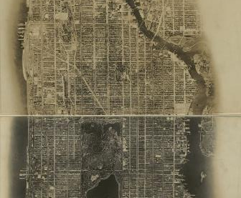
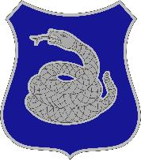
WHAT’S IN A NAME?
Infantry:
Soldiers trained in ground combat
Regiment:
Organization in Army made up of about 2,000-5,000 soldiers
Soldiers of the 369th Infantry Regiment in the trenches in France (NARA/S.C. Abbott, 1918)
Soldiers of the 369th Infantry Regiment marching in New York City (NARA/Paul Thompson, 1919)
Harlem:
Historically African American neighborhood in New York
Rattlers:
Distinctive unit insignia features a silver rattlesnake
369th Infantry Regiment distinctive unit insignia. (The Institute of Heraldry)
Aerial image of New York City(LOC/1921)
ARLINGTON NATIONAL CEMETERY HISTORY EDUCATION SERIES
Notes:
Infantry soldiers are trained in ground combat.
A regiment is made up of about 2,000-5,000 soldiers.
Many members of the 369th Infantry Regiment were from the Harlem neighborhood of New York. It became famous as a center of African American culture during the 1920s – a period called the Harlem Renaissance.
Each Army unit has a distinctive unit insignia worn by soldiers of that unit. The 369th Infantry Regiment’s distinctive unit insignia featured a silver rattlesnake.he
Photo: Abbott, S.C. 111-SC-11914. Photograph. May 4, 1918. National Archives. https://catalog.archives.gov/id/55183953
Photo: Thompson, Paul. Parade of returned fighters of the famous 369th [African American] Infantry at the Flatiron Building, New York City [at] the start of the parade. Photograph. February 17, 1919. National Archives. https://catalog.archives.gov/id/533510
Photo: Aerial survey, Manhattan Island, New York City. Photograph. August 4, 1921. New York City, New York: Fairchild Aerial Camera Corporation. Library of Congress. https://www.loc.gov/resource/g3804n.ct003447/
Illustration: 369th Support Battalion Distinctive Unit Insignia. Illustration. U.S. Army, The Institute of Heraldry. https://tioh.army.mil/Catalog/HeraldryMulti.aspx?CategoryId=8274&grp=2&menu=Uniformed%20Services

Slide 4
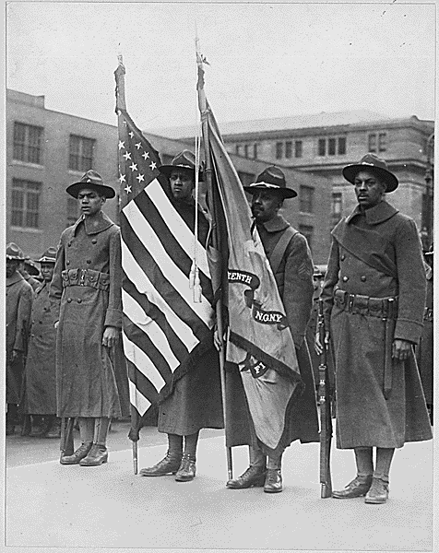
BEGINNINGS
Began in June 1913 as the 15th New York Regiment of the New York Army National Guard
Redesignated the 369th Infantry Regiment in 1916
Drilled in New York before moving to South Carolina for combat training
1917 photo of soldiers of the 369th Infantry Regiment holding the 15th New York National Guard Regiment flag. (NARA/Paul Thompson)
ARLINGTON NATIONAL CEMETERY HISTORY EDUCATION SERIES
Notes:
The regiment came into being in June 1913 in the New York Army National Guard as the 15th New York Regiment. The National Guard is a reserve component of the United States military with designated units for all fifty states, Washington, D.C., and the territories of Guam and the Virgin Islands. State governors and the president can mobilize the National Guard for domestic or international conflicts.
The Army re-organized the 15th into the 369th in 1916. Called into federal service upon the outbreak of World War I, the regiment drilled in New York prior to moving to South Carolina, where it undertook combat training.
Photo: Thompson, Paul. [African American] color bearers of 15th Regiment Infantry, New York National Guard, New York City. (369th, new designation) Photograph. 1917. National Archives. https://catalog.archives.gov/id/533598

Slide 5
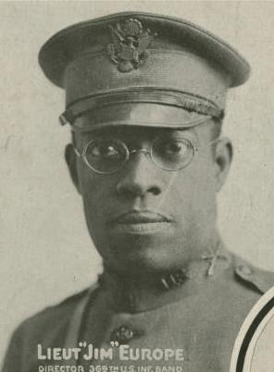
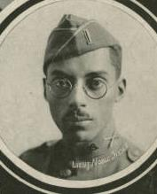
EXPERIENCING RACISM
Experienced significant racism in
South Carolina
Incident: Hotel refused to sell newspaper to two soldiers – Lieutenant James Reese Europe and Sergeant Noble Sissle. White soldiers from the 27th Division came to their defense.
James Reese Europe and Noble Sissle in uniform. (University of South Carolina/Alex Rice, 1919)
ARLINGTON NATIONAL CEMETERY HISTORY EDUCATION SERIES
Notes:
The unit bore the brunt of significant racism while in South Carolina: in one famous case a hotel refused to sell a newspaper to two soldiers in the regiment, Lieutenant James Reese Europe and Sergeant Noble Sissle. Several white soldiers from the 27th Infantry Division came to the defense of their comrades from the 369th, averting trouble.
Photo: Rice, Alex. Mirandy: that gal o’mine. Photograph and illustration. New York City, New York: Jos. W. Stern & Co. 1919. University of South Carolina. https://digital.tcl.sc.edu/digital/collection/jbgrtwrsm/id/5656

Slide 6
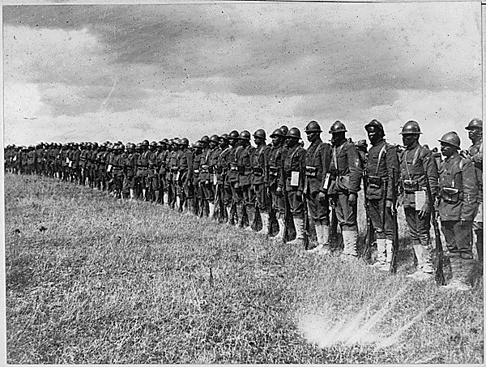
EXPERIENCING RACISM
Arrived in France 1918 and were assigned to labor roles instead of combat
White American units refused to fight alongside them, so they were assigned to the French Army
1919 photo of soldiers of the 369th Infantry Regiment in France. (NARA)
ARLINGTON NATIONAL CEMETERY HISTORY EDUCATION SERIES
Notes:
Arriving in France in early 1918, the 369th found itself relegated to unloading ships and other menial labor instead of further combat training. At the time, many African American military units were given non-combat assignments due to racism and prejudice about their abilities on the battlefield.
Anxious to prove themselves in combat, the 369th soon found itself in a quandary: white officers refused to brigade the regiment with white soldiers. In April of 1918 the Army assigned the 369th to the French Army.
Photo: Negro Troops in France. Picture shows part of the 15th Regiment Infantry New York National Guard. Photograph. International Film Service, 1919. National Archives. https://catalog.archives.gov/id/533488

Slide 7
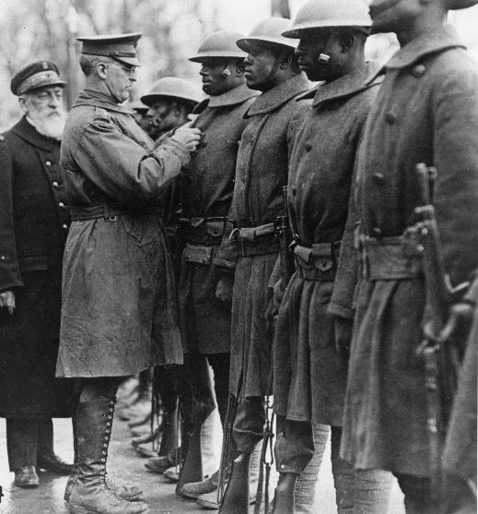
COMBAT EXPERIENCE
Distinguished themselves in combat, especially during Second Battle of the Marne
French nicknamed them the “Men of Bronze,” Germans who they fought nicknamed them the “Hellfighters”
Several soldiers recognized for valor – Medal of Honor, Distinguished Service Cross, and French Croix de Guerre
1919 photo Major General Eli A. Helmick awarding the Distinguished Service Cross to members of the 369th Infantry Regiment in recognition of their valor. (NARA/P.A. Pellison)
ARLINGTON NATIONAL CEMETERY HISTORY EDUCATION SERIES
Notes:
Here they distinguished themselves in combat, seeing extensive action in the Second Battle of the Marne. They gained the respect of the French, who nicknamed them the “Men of Bronze.” The Germans, bearing the brunt of their ferocity, named them “Hellfighters.”
When the war ended, the unit has proven itself in multiple ways. In combat, several soldiers of the unit received honors as great as the Medal of Honor, the French Croix de Guerre, and the Distinguished Service Cross.
Photo: Pellison, P.A. Maj. Gen. Eli A. Helmick decorating men with D.S.C. Medals for exceptional bravery. Brest, Finistere, France. Photograph. January 27, 1919. National Archives. https://catalog.archives.gov/id/86709991

Slide 8
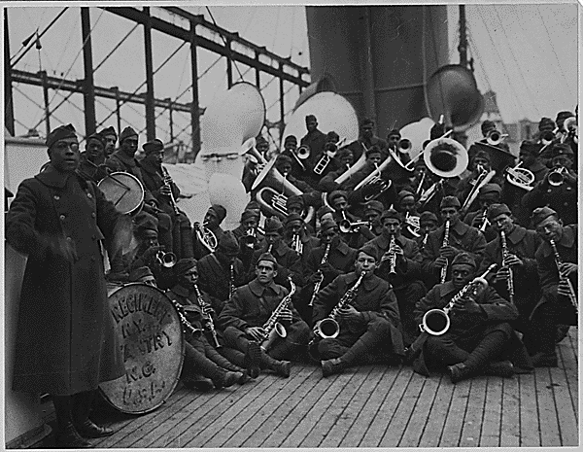
369th INFANTRY REGIMENTAL BAND
Regiment’s marching band led by James Reese Europe introduced European audiences to jazz
1919 photo the 369th Infantry Regimental Band aboard a ship, returning to New York City. (NARA)
ARLINGTON NATIONAL CEMETERY HISTORY EDUCATION SERIES
Notes:
During World War I, the 369th Infantry Regimental Band was led by James Reese Europe, a talented bandleader who had already distinguished himself in the New York music and theater scene. Europe put together the best band he could, even traveling to Puerto Rico to recruit members. The band toured across France in February and March of 1918 and proved instrumental in introducing early jazz to awestruck European audiences.
Photo: [African American] Jazz Band and Leader Back with [African American] 15th New York. Photograph. February 12, 1919. National Archives. https://catalog.archives.gov/id/533506

Slide 9
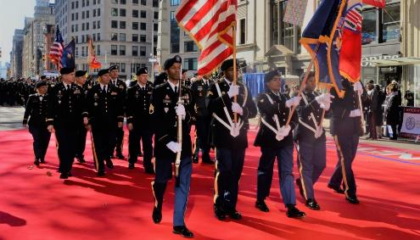
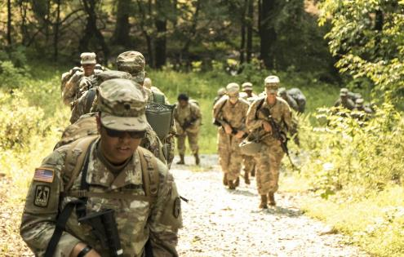
LATER YEARS
After World War I, remained in service as 369th Coast Artillery Battalion and was converted to an anti-aircraft unit
Deployed in New York, West Coast, and Hawaii
Served in New Guinea and Philippines during World War II as anti-aircraft battalion
Lives on as 369th Sustainment Brigade in New York Army National Guard
2018 photo of soldiers of the 369th Sustainment Brigade marching in the New York City Veterans Day Parade. (New York National Guard/Mark Getman)
2018 photo of soldiers of the 369th Sustainment Brigade in training. (New York National Guard/Nnaemeka Onyeagwa)
ARLINGTON NATIONAL CEMETERY HISTORY EDUCATION SERIES
Notes:
After the unit returned home, it remained in New York state service as the 369th Coast Artillery Battalion. The Army later converted them—as well as other Coast Artillery battalions—into an anti-aircraft unit. It deployed both in its native state, but also in the West Coast and Hawaii.
In World War II, the unit also served, this time in the Pacific Theater of Operations. It continued its service as an anti-aircraft battalion. Attached to the 93rd Infantry Regiment, the 369th saw action in New Guinea and the Philippines against the Japanese.
The regiment survives today as the 369th Sustainment Brigade.
Photo: Getman, Mark. Soldiers of the 369th Sustainment Brigade March in Veterans Day Parade [Image 11 of 28]. Photograph. November 11, 2018. New York National Guard. DVIDS. https://www.dvidshub.net/image/4897432/soldiers-369th-sustainment-brigade-march-veterans-day-parade
Photo: Onyeagwa, Nnaemeka. 369th Sustainment Brigade Soldiers conduct field training [Image 25 of 33]. Photograph. August 16, 2018. New York National Guard. DVIDS. https://www.dvidshub.net/image/4671789/369th-sustainment-brigade-soldiers-conduct-field-training

Slide 10
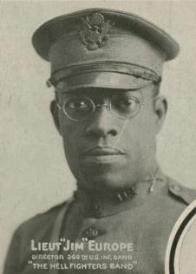
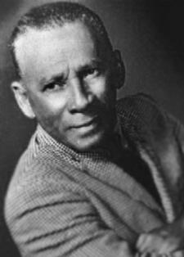
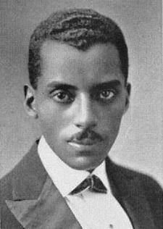

NOTABLE MEMBERS
James Reese (Jim) Europe
Regimental bandleader, popularized jazz in Europe
Rafael Hernández Marín
One of the most prolific and famous Puerto Rican composers
(University of South Carolina/ Alex Rice, 1919)
(Enciclopedia de Puerto Rico/
ca. 1960)
Noble Sissle
Co-wrote first hit Broadway musical written by and about African Americans
Spottswood (Spot) Poles
Professional baseball player in the Negro League known for his speed
(National Baseball Hall of Fame/
1911)
(New York Public Library/1923)
ARLINGTON NATIONAL CEMETERY HISTORY EDUCATION SERIES
Notes:
James Reese Europe – also known as Jim Europe
Jim Europe was the bandleader of the 369th Regimental Band, which traveled around France performing for French, British, and American audiences. The band played traditional military marches as well as early jazz and sparked the popularity of jazz in Europe. Europe is interred at Arlington National Cemetery.
Photo: Rice, Alex. Mirandy: that gal o’mine. Photograph and illustration. New York City, New York: Jos. W. Stern & Co. 1919. University of South Carolina. https://digital.tcl.sc.edu/digital/collection/jbgrtwrsm/id/5656
Noble Sissle
Noble Sissle was the lead vocalist of Jim Europe’s band in France. After the war, he and his friend Eubie Blake wrote the musical “Shuffle Along,” which was the first hit Broadway musical written by and about African Americans.
Photo: Noble Sissle; Musician. Photograph. 1923. Schomburg Center for Research in Black Culture, Jean Blackwell Hutson Research and Reference Division, The New York Public Library. http://digitalcollections.nypl.org/items/510d47df-75b3-a3d9-e040-e00a18064a99
Rafael Hernández Marin
Rafael Hernández was a member of Jim Europe’s band in France. In his lifetime, he wrote hundreds of songs, and his music became an important part of Puerto Rican culture.
Photo: Rafael Hernández. Photograph. ca. 1960. Enciclopedia de Puerto Rico. https://enciclopediapr.org/en/encyclopedia/rafael-hernandez/
Spottswood Poles
Spottswood, or “Spot,” Poles was a professional baseball player in the Negro League. He was known for his speed, and was nicknamed the “Black Ty Cobb,” after one of the best Major League Baseball players. Poles fought with the 369th during World War I and was awarded a Purple Heart and five battle stars. Poles is interred at Arlington National Cemetery.
Photo: Lincoln Giants Team Photograph, 1911. Photograph. 1911. National Baseball Hall of Fame and Museum. https://collection.baseballhall.org/PASTIME/lincoln-giants-team-photograph-1911-2

Slide 11
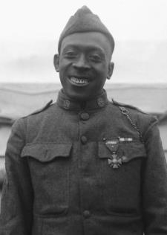
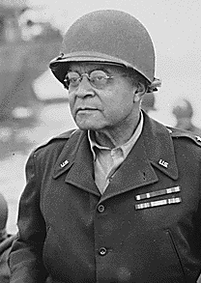
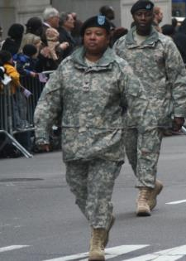
NOTABLE MEMBERS
(U.S. Army/1919)
(NARA/1944)
(New York National Guard/2009)
Henry Johnson
Posthumously awarded Medal of Honor for heroism in hand-to-hand combat
Benjamin O. Davis Sr.
Became first African American general in U.S. military in 1940
Stephanie Dawson
Became first woman to command a brigade in New York Army National Guard in 2008
ARLINGTON NATIONAL CEMETERY HISTORY EDUCATION SERIES
Notes:
Henry Johnson
On May 15, 1918, Henry Johnson and a fellow soldier fought off a German raiding party in the Argonne Forest of France. Johnson engaged in hand-to-hand combat to rescue his fellow soldier from being taken prisoner and was awarded the French Croix de Guerre for his valor. Due to racism at the time, he was not awarded the Medal of Honor until 2015, long after his death. Johnson is interred at Arlington National Cemetery.
Photo: Sergeant Henry Johnson. Photograph. 1919. U.S. Army. https://www.army.mil/medalofhonor/johnson/
Benjamin O. Davis Sr.
Benjamin O. Davis Sr. took command of the 369th Regiment, New York National Guard in 1938. In 1940, he was promoted to brigadier general, becoming the first African American general in the U.S. military. Davis is interred at Arlington National Cemetery.
Photo: Brigadier General Benjamin O. Davis watches a Signal Corps crew erecting poles, somewhere in France. Photograph. August 8, 1944. National Archives. https://catalog.archives.gov/id/531202
Stephanie Dawson
Stephanie Dawson took command of the 369th Sustainment Brigade in 2008, becoming the first woman to command a brigade in the New York Army National Guard. Her military service also included managing response logistics to the 9/11 terrorist attacks in New York and deployment to Iraq.
Photo: NY National Guard Commemorates 90th Anniversary of NYC Veterans' Salute [Image 2 of 2]. Photograph. November 11, 2009. New York National Guard. DVIDS. https://www.dvidshub.net/image/222513/ny-national-guard-commemorates-90th-anniversary-nyc-veterans-salute

Slide 12
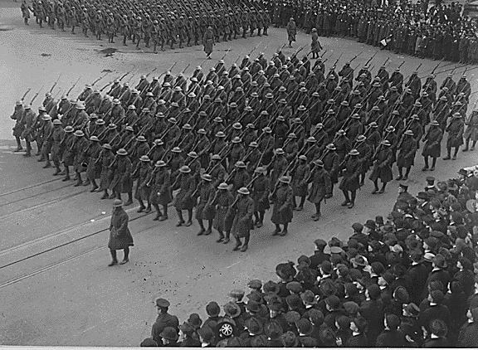
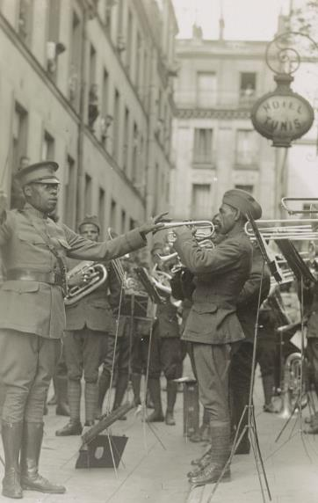
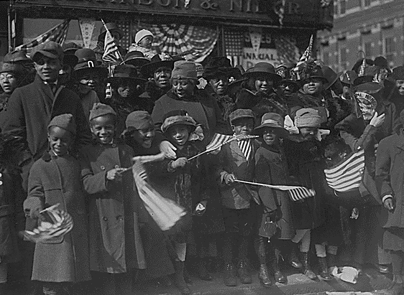
LEGACY
All of New York celebrated their return
Jazz became very popular in Europe and opened doors for Black musicians and artists
1919 photo of soldiers of the 369th Infantry regiment marching in their homecoming parade. (NARA)
1918 photo of the 369th Infantry Regimental Band playing in France. (LOC)
1919 photo of well-wishers at the 369th Infantry Regiment homecoming. (NARA)
ARLINGTON NATIONAL CEMETERY HISTORY EDUCATION SERIES
Notes:
When the 369th came home from the trenches in 1919, they returned to a society that was still deeply prejudiced against African Americans. However, stories of their bravery and valor had won them fame in Europe and the United States. As the first of New York’s National Guardsmen to return from France, the New York City Mayor’s Committee of Welcome to the Homecoming Troops organized a parade solely for the 369th Infantry Regiment. The popularity of jazz continued to grow in Europe, opening doors for Black musicians and artists and inspiring admiration and imitation of other African American musical traditions.
Photo: Colonel Hayward's "Hell Fighters" in parade. Photograph. February 18, 1919. National Archives. https://catalog.archives.gov/id/533518
Photo: Colored Troops - Colored Children gathered along line of march to extend royal welcome to their daddies of the 369th (old 15th NY) regiment, as the famous fighters pass up 5th Avenue in welcome home parade. Photograph. February 21, 1919. https://catalog.archives.gov/id/26431314
Photo: Genuine jazz for the yankee wounded In the courtyard of a Paris hospital for the American wounded, an American negro military band, led by Lt. James R. Europe, entertains the patients with real American jazz. Photograph. 1918. Army Signal Corps. Library of Congress. https://www.loc.gov/item/2016651602/

Slide 13
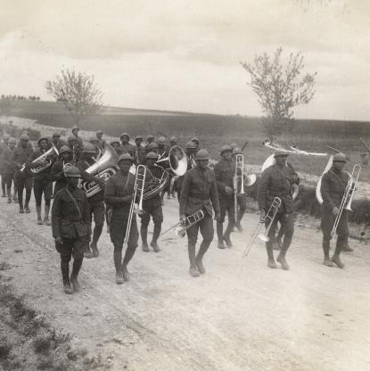
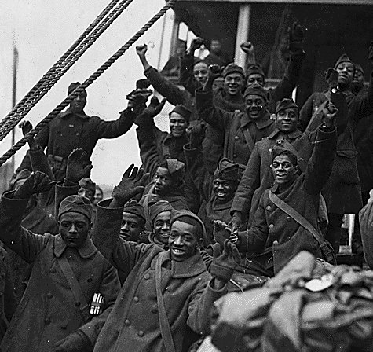
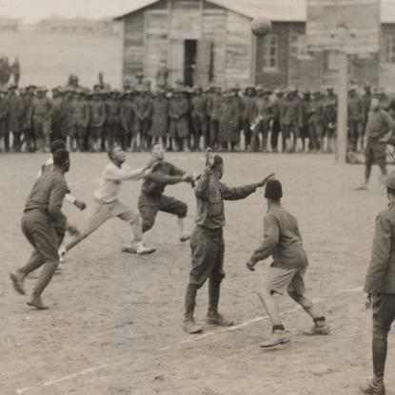
CONNECTIONS
Does the story of the 369th Infantry Regiment remind you of anything else you have learned? What connections can you make to your prior knowledge?
1918 photo of the 369th Infantry Regimental Band marching in France. (NARA/S.C. Abbott)
1919 photo of soldiers of the 369th Infantry Regiment on their way home from war. (NARA/S.C. Abbott)
1918 photo of soldiers of the 369th Infantry Regiment playing basketball in France. (NARA)
ARLINGTON NATIONAL CEMETERY HISTORY EDUCATION SERIES
Notes:
Now that you’ve been introduced to the 369th Infantry Regiment, what connections can you make to other things you have learned in class?
Photo: Abbott, S.C. 111-SC-11907. Photograph. June 6, 1918. National Archives. https://catalog.archives.gov/id/55183939
Photo: Thompson, Paul. The Famous 369th Arrive in New York City. Photograph. 1919. National Archives. https://catalog.archives.gov/id/533496
Photo: 111-SC-6319 - St. Nazaire, France, 15th New York Infantry, now the 369th Infantry, a Colored Regiment engage in a basketball game. Photograph. February 13, 1918. National Archives. https://catalog.archives.gov/id/55173542

